Slide 1
Clase Inglés: semana del 17 - 21 de agosto *REPASO PARA LA PRUEBA ORAL
ENGLISH

Slide 2
CLASS 11
1st grade
English class
AUGUST 2020

Slide 3
INSTRUCCIONES
1. Silenciar el micrófono al entrar a la clase.
2. Si el internet falla se recomiendo apagar la cámara.
3. Usar el chat para preguntas o levantar la mano.
4. Para participar prender el micrófono(sólo si el profesor/a se lo indica).
5. Ser respetuoso y utilizar lenguaje apropiando.

Slide 4
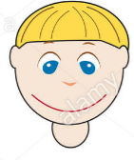
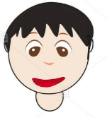
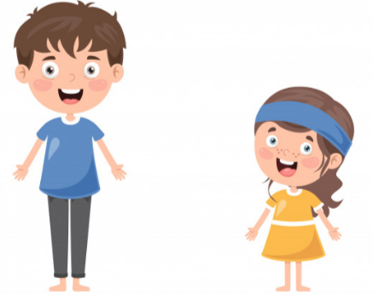
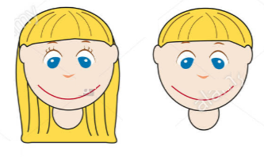
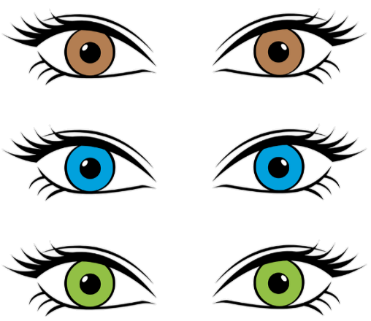
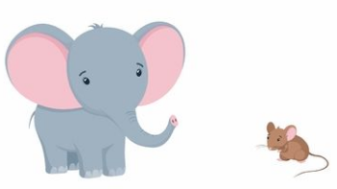
To review descriptive words to describe people orally.
TALL - SHORT
COLORS
LONG - SHORT
Hair Hair
BIG - SMALL

Slide 5
DESCRIPTIVE WORDS GAME

Slide 6
It has…
A: LONG ARMS
C: 3 EYES
B: LONG LEGS
D: SMALL MOUTH
1
Notes:
A

Slide 7
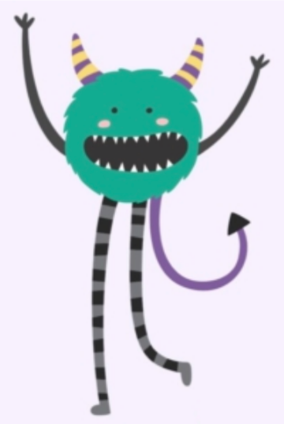
It has…
A: LONG LEGS
C: BIG EYES
B: RED HAIR
D: SHORT LEGS
2
Notes:
A

Slide 8
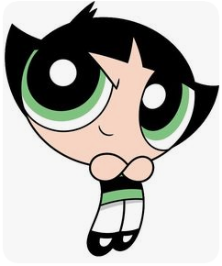
She has…
A: BIG GREEN EYES
C: SMALL RED EYES
B: BIG BLUE EYES
D: SMALL GREEN EYES
3
Notes:
A

Slide 9
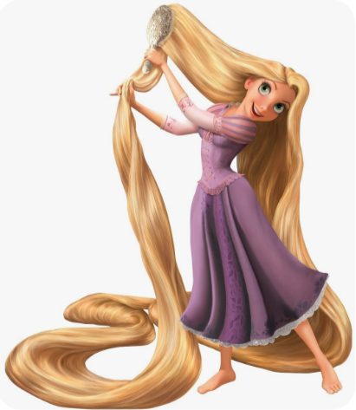
She has…
A: SHORT LEGS
C: LONG HAIR
B: BIG EARS
D: SHORT HAIR
4
Notes:
C

Slide 10
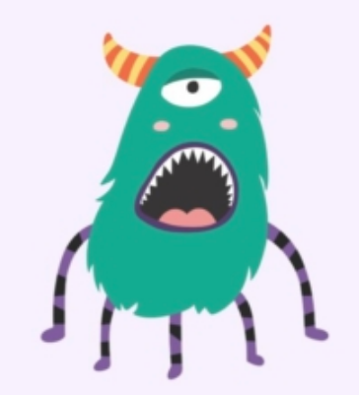
Profesiones y oficios
It has…
A: 3 LEGS and BLUE HAIR
C: 4 LEGS and RED HAIR
B: 2 LEGS and PURPLE HAIR
D: 5 LEGS and GREEN HAIR
5
Notes:
D

Slide 11
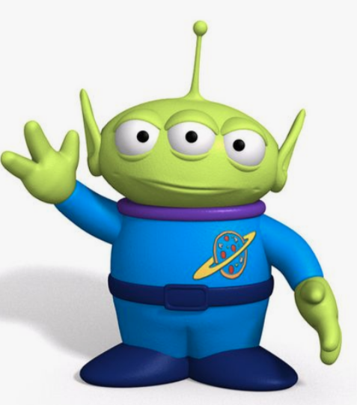
It is…
A: TALL and YELLOW
C: SHORT and PINK
B: BLUE and has 1 EYE
D: SHORT and GREEN
6
Notes:
D

Slide 12
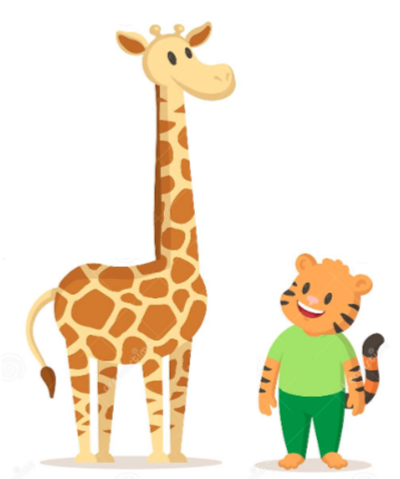
The giraffe is…
A: TALL
C: SHORT
B: FAT
D: SAD
8
Notes:
A

Slide 13
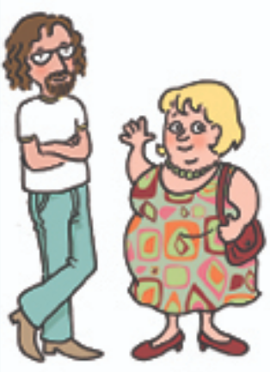
She is…
A: TALL and THIN
C: SHORT and THIN
B: SHORT and FAT
D: BLONDE and THIN
9
Notes:
B

Slide 14
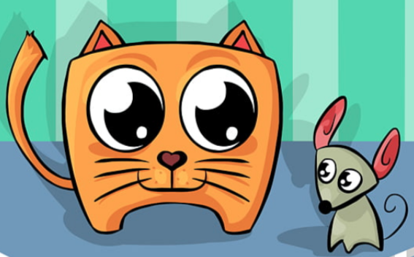
The cat has…
A: YELLOW EYES
C: BIG EYES
B: GREEN EYES
D: SMALL EYES
10
Notes:
C

Slide 15
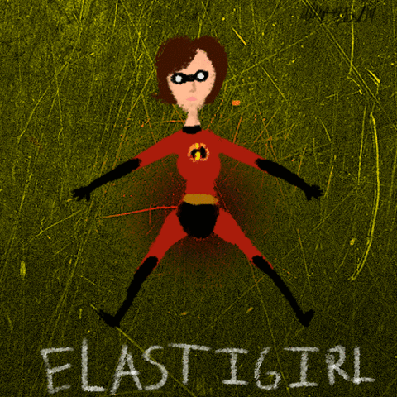
She has…
A: SHORT ARMS
C: LONG LEGS
B: a BIG NOSE
D: BIG EARS
11
Notes:
C

Slide 16
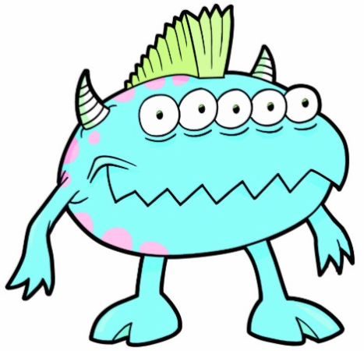
It has…
A: 6 eyes
C: 5 eyes
B: 10 eyes
D: 4 eyes
12
Notes:
C

Slide 17
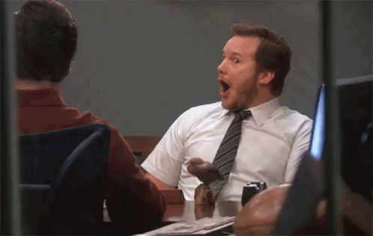
LET´S CREATE A MONSTER!
LISTEN and DRAW a MONSTER
Notes:
Bring a notebook and color markers

Slide 18
MONSTER ROULETTE
IT IS…
TALL
SHORT
TALL
SHORT
SHORT
TALL
TALL
CLICK
SHORT
SHORT
TALL
TALL
SHORT
SHORT
TALL
TALL
SHORT
SHORT
TALL
SHORT
TALL

Slide 19
MONSTER ROULETTE
IT IS…
FAT
THIN
FAT
THIN
THIN
THIN
FAT
FAT
FAT
CLICK
THIN
THIN
FAT
FAT
THIN
THIN
FAT
FAT
THIN
THIN
FAT
THIN
FAT

Slide 20
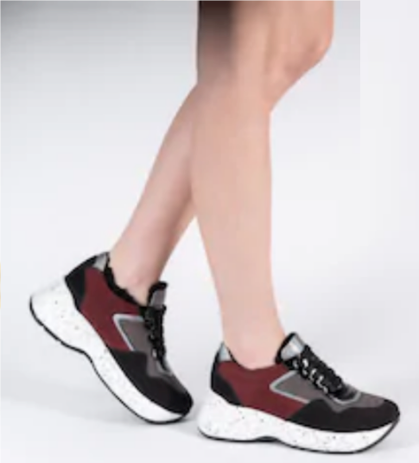
MONSTER ROULETTE
It has…
LEGS
ROLL THE DICE TO SEE HOW MANY LEGS
SHORT
LONG
LONG
SHORT
LONG
SHORT
SHORT
CLICK
LONG
https://www.youtube.com/watch?v=9L-VhUmir-A
LONG
SHORT
SHORT
LONG
LONG
SHORT
SHORT
LONG
LONG
SHORT
LONG
SHORT

Slide 21
MONSTER ROULETTE
It has…
ARMS
SHORT
ROLL THE DICE TO SEE HOW MANY LEGS the monster has
LONG
SHORT
LONG
LONG
SHORT
SHORT
CLICK
LONG
LONG
SHORT
SHORT
LONG
LONG
SHORT
SHORT
LONG
https://www.youtube.com/watch?v=9L-VhUmir-A
LONG
SHORT
LONG
SHORT

Slide 22
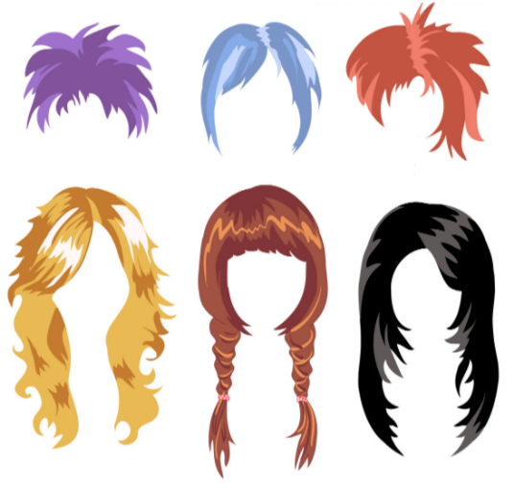
MONSTER ROULETTE
It has…
HAIR
SHORT
LONG
SHORT
LONG
LONG
SHORT
SHORT
CLICK
LONG
What is its hair color?
LONG
SHORT
SHORT
LONG
LONG
SHORT
SHORT
LONG
LONG
SHORT
LONG
SHORT

Slide 23
MONSTER ROULETTE
IT IS…
CLICK

Slide 24
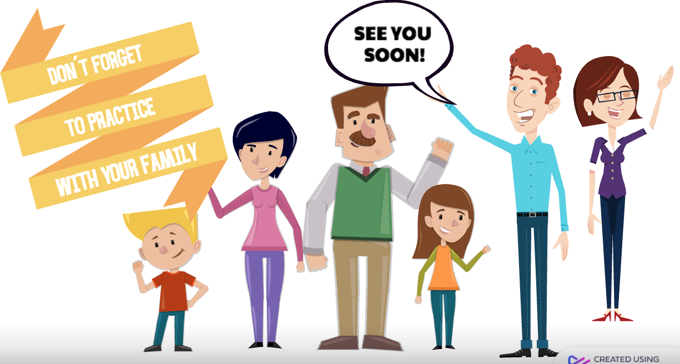

Slide 25
Any question don´t hesitate to contact us: giovanna.cima@ssccmanquehue.cl
cesar.ferrada@ssccmanquehue.cl

