Slide 1
Clase 10: semana del 10 - 14 de agosto *No hacer nada, se explicará en clases.
ENGLISH

Slide 2
CLASS 10
1st grade
English class
AUGUST 2020

Slide 3
INSTRUCCIONES
1. Silenciar el micrófono al entrar a la clase.
2. Si el internet falla se recomiendo apagar la cámara.
3. Usar el chat para preguntas o levantar la mano.
4. Para participar prender el micrófono(sólo si el profesor/a se lo indica).
5. Tener el libro a mano.
6. Ser respetuoso y utilizar lenguaje apropiando.

Slide 4
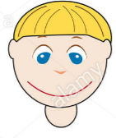
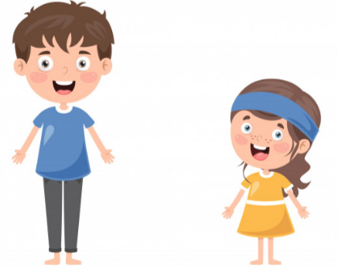
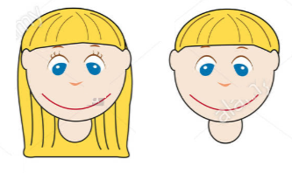
To consolidate descriptive words to describe people and animals orally.
COLORS
LONG - SHORT
Hair Hair
TALL - SHORT

Slide 5
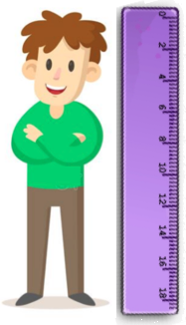
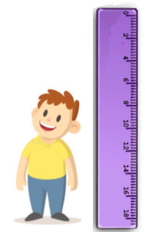
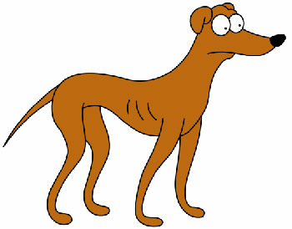
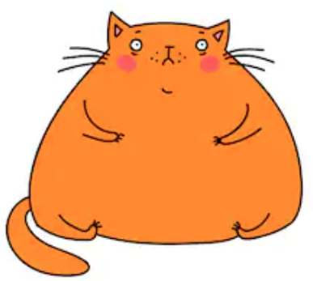
DESCRIPTIVE WORDS
HE is TALL
HE is SHORT
IT is THIN
IT is FAT

Slide 6
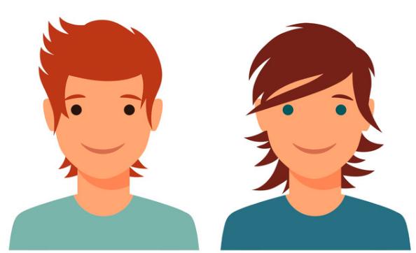
DESCRIPTIVE WORDS
SHE/ HE/ IT HAS….
HAIR
LONG HAIR
SHORT HAIR
BLACK HAIR
BLONDE HAIR
RED HAIR
BROWN HAIR
EYES
BROWN
BLUE
GREEN
BIG
SMALL

Slide 7
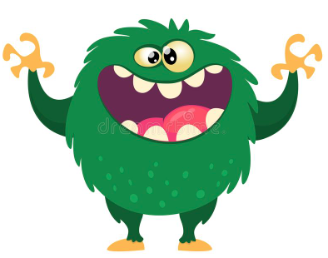
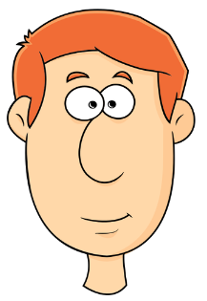
MOUTH
BIG
SMALL
IT has a BIG MOUTH
HE has a SMALL MOUTH

Slide 8
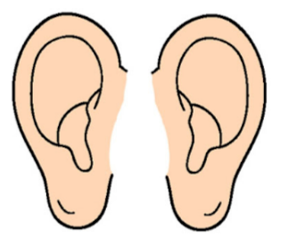
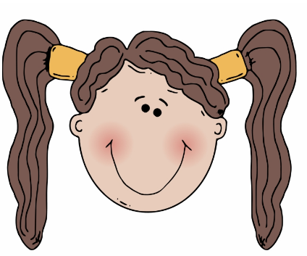
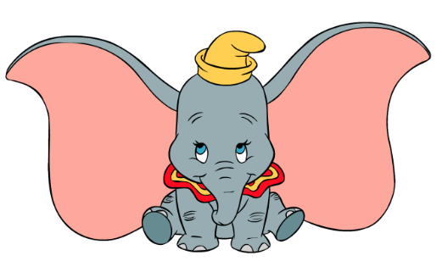
EARS
BIG
SMALL
IT has BIG EARS
SHE has SMALL EARS

Slide 9
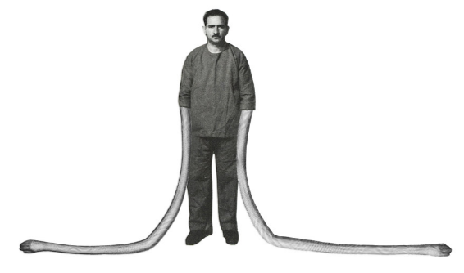
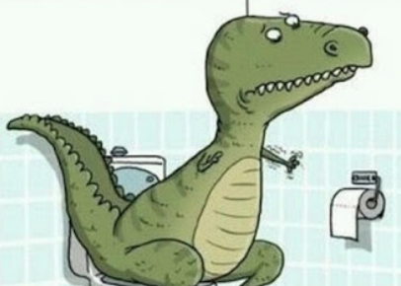
ARMS
LONG
SHORT
HE has LONG ARMS
IT has SHORT ARMS
Notes:
.

Slide 10
Let´s practice!

Slide 11
ITS name is TIM
TIM has…
4 EARS
BIG – SMALL EARS
BIG - SMALL
MOUTH
2 SHORT – LONG LEGS

Slide 12
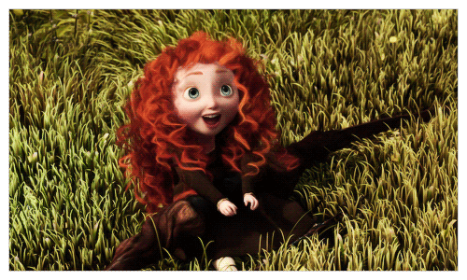
SHE is MERIDA
MERIDA has…
SHE has RED HAIR
BLUE EYES
BIG – SMALL
EYES
SHE has
LONG – SHORT
HAIR

Slide 13
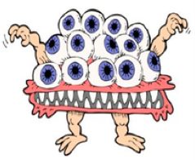
ITS name is FRED
FRED has…
13 EYES
BIG – SMALL
EYES
BIG – SMALL
MOUTH

Slide 14
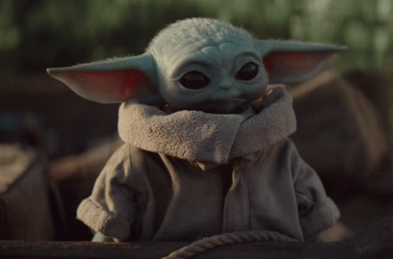
ITS name is YODA
YODA has…
2
YODA IS?
BIG – SMALL EARS
GREEN - YELLOW
2
BIG - SMALL
BLACK
EYES

Slide 15
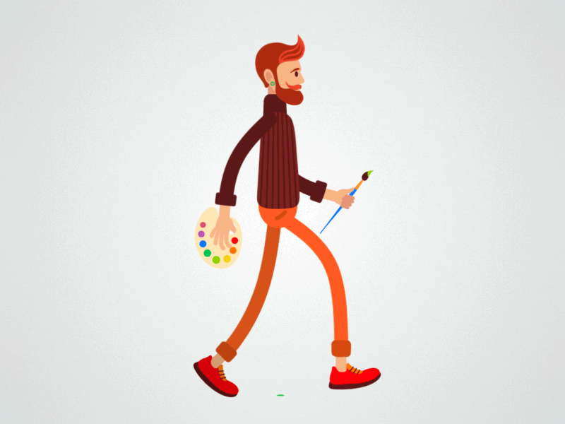
HE is JOHN
HE IS
TALL - SHORT
HE HAS
BLOND - RED hair
HE IS
FAT - THIN
HE HAS
LONG - SHORT

Slide 16
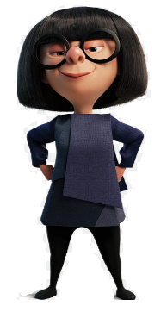
EXTRA
SHE is EDNA
SHE IS
TALL - SHORT
SHE IS
FAT - THIN
SHE HAS
BLACK - RED hair
SHE HAS
LONG - SHORT

Slide 17
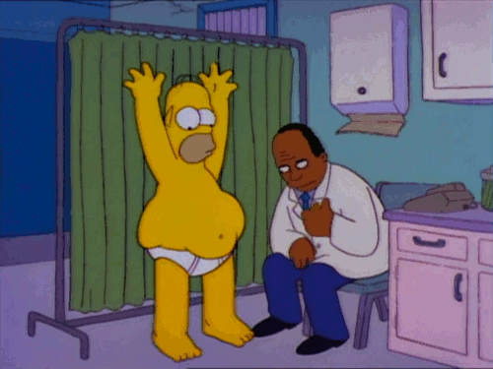
EXTRA
HE is HOMER
HE IS
THIN - FAT
HE HAS
SMALL – BIG
EYES

Slide 18
EXTRA
SHE is ELASTIC GIRL

Slide 19
MEMORY GAME!
https://matchthememory.com/sscc

Slide 20
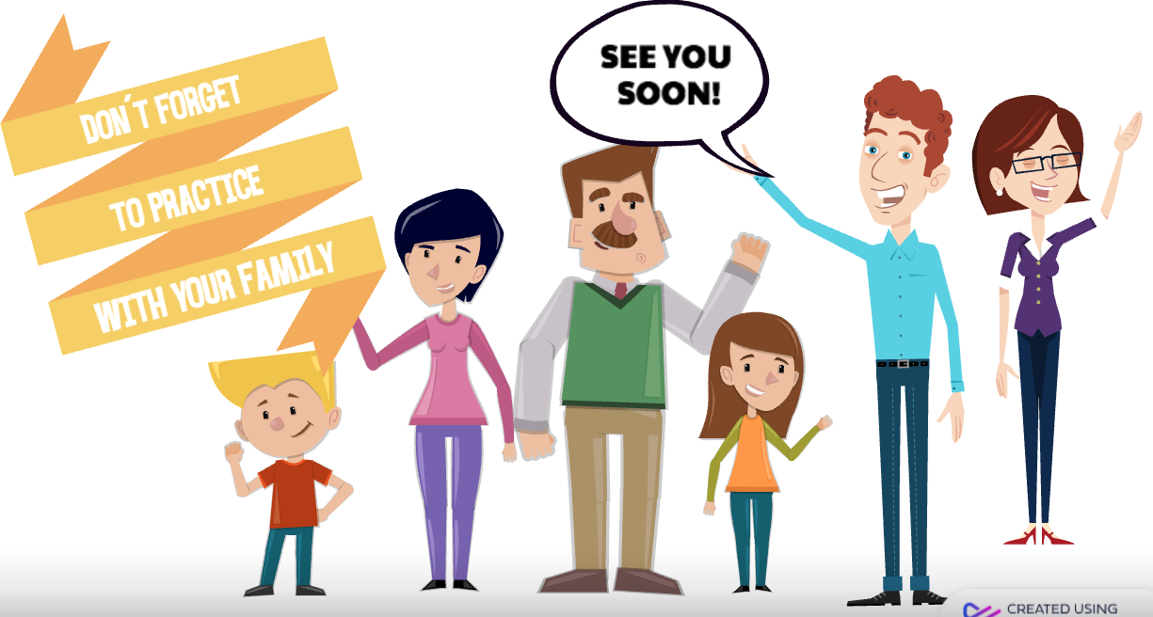

Slide 21
Any question don´t hesitate to contact us: giovanna.cima@ssccmanquehue.cl
cesar.ferrada@ssccmanquehue.cl

