Slide 1
DO NOT PRINT THIS PPT
LISTENING COMPREHENSION
1st grade
English class
MAY 2020

Slide 2
*Por favor ayudar a leer estas diapositivas a los estudiantes
https://www.youtube.com/watch?v=dDHJW4r3elE

Slide 3
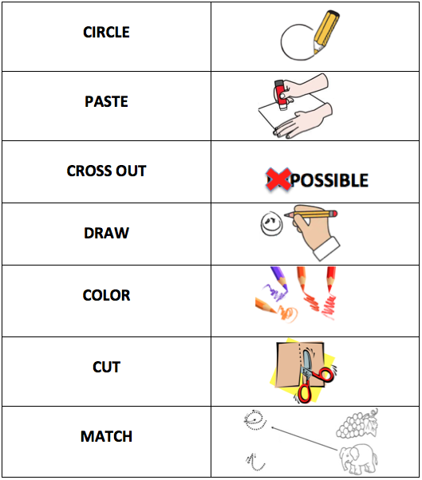

Slide 4
OBJECTIVE: Identify general and specific information from an oral text to show listening comprehension.

Slide 5
https://www.youtube.com/watch?v=WeRY_YN35zI
AND
You can
the video for your better understanding.

Slide 6
Listen carefully
Be focused
You don´t need to understand every word of the listening passage.
Try to guess the meaning using the context.

Slide 7
Strategies for a good listening comprehension
1) Pre-listening
- Scan: Read the questions
- Predict
- Prepare your mind
2 While-listening (during)
- Listen Carefully
- Mark the correct answers
3) Post-listening
- Reflect

Slide 8
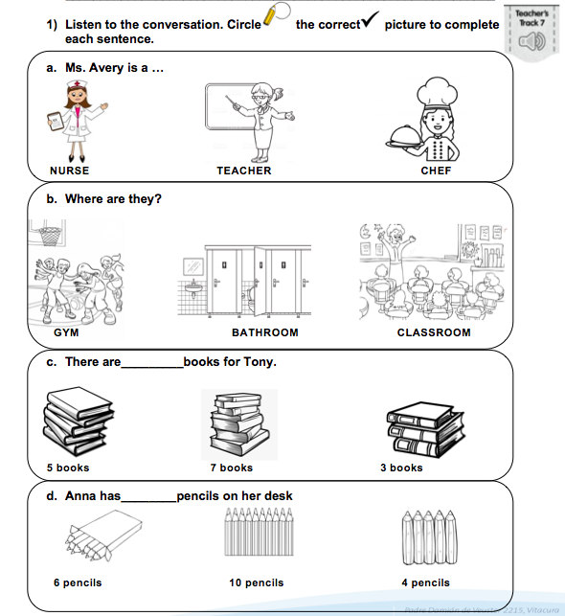

Slide 9
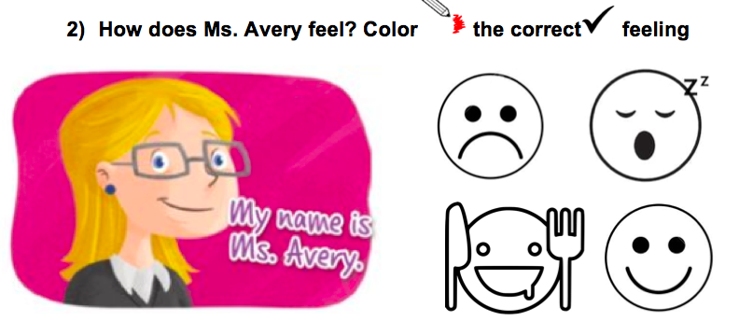

Slide 10
POST-LISTENING

Slide 11
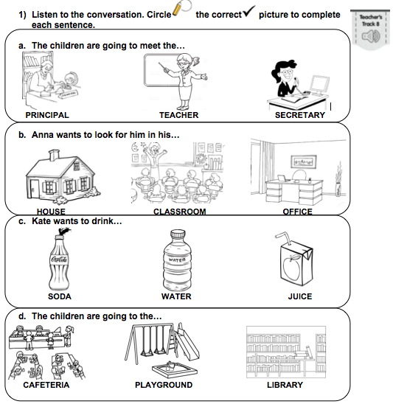

Slide 12
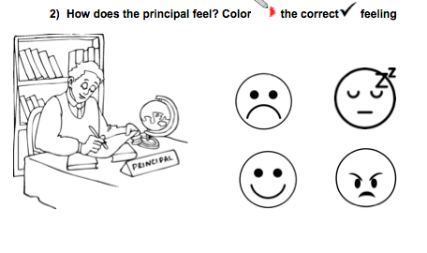

Slide 13
Any question don´t hesitate to contact us: giovanna.cima@ssccmanquehue.cl
cesar.ferrada@ssccmanquehue.cl

Slide 14
