Slide 1
DO NOT PRINT THIS PPT
PEOPLE and PLACES at SCHOOL
1st grade
English class
MAY 2020

Slide 2
*Por favor ayudar a leer estas diapositivas a los estudiantes
https://www.youtube.com/watch?v=dDHJW4r3elE

Slide 3
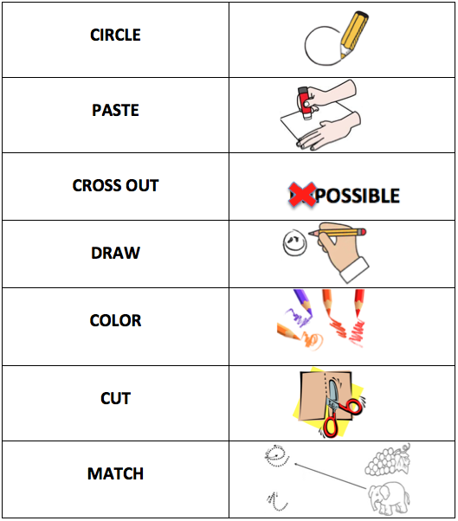

Slide 4
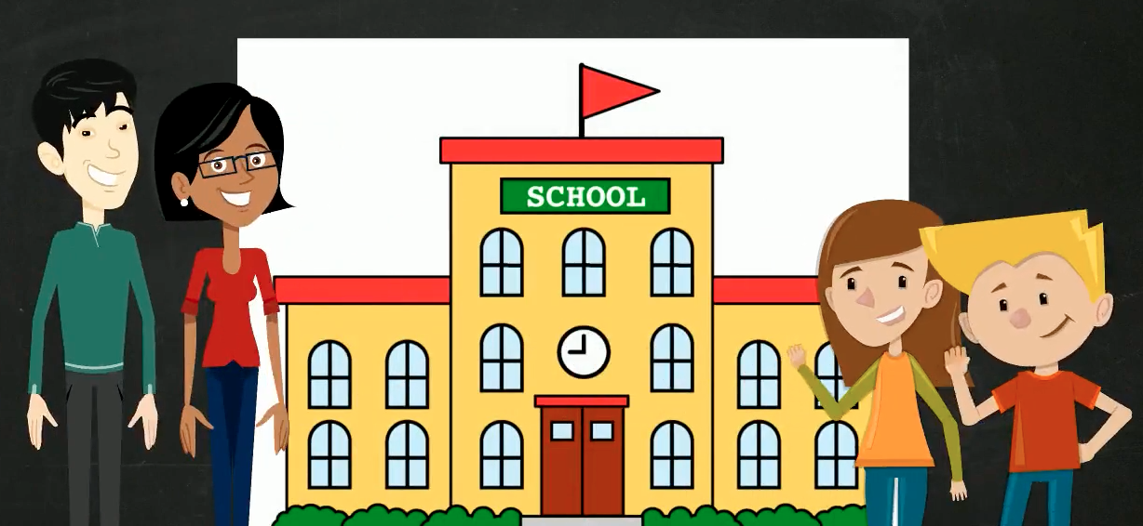
OBJECTIVE: Identify PEOPLE and PLACES at school.

Slide 5
https://www.youtube.com/watch?v=hfUakASslcM&t=50s
AND
You can
the video for your better understanding.

Slide 6
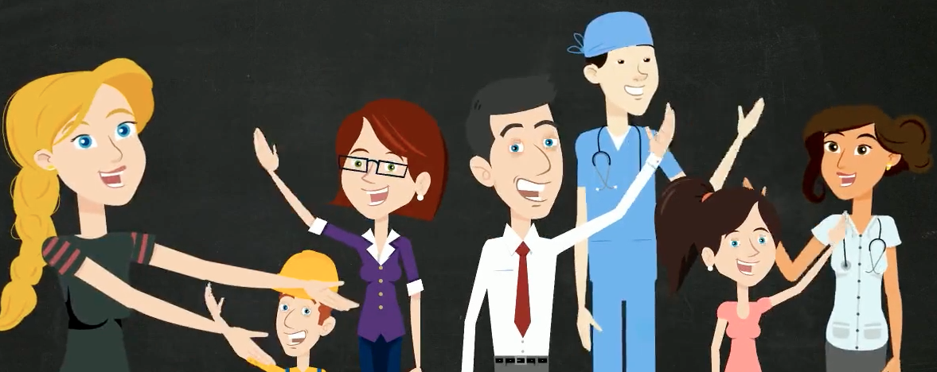

Slide 9
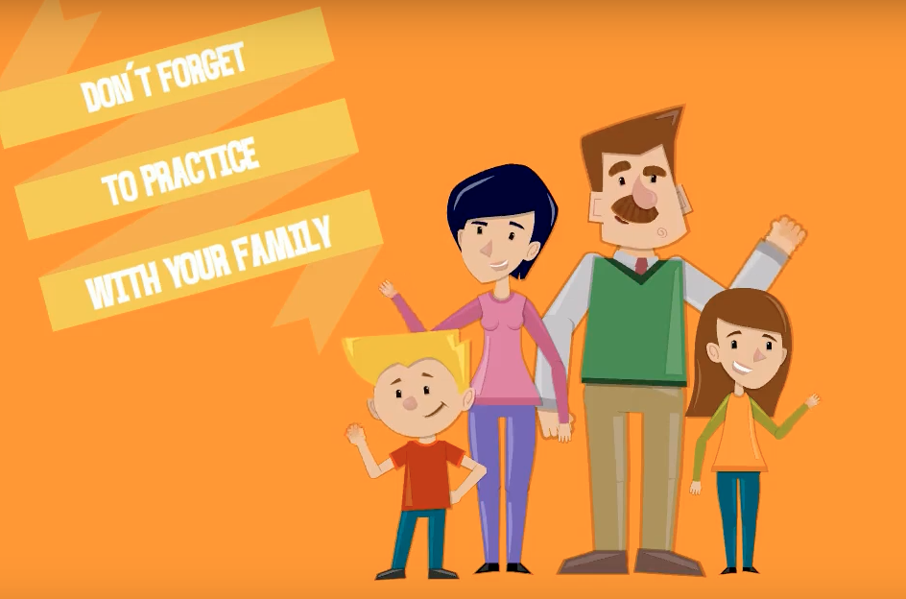
Any question don´t hesitate to contact us: giovanna.cima@ssccmanquehue.cl
cesar.ferrada@ssccmanquehue.cl

Slide 10
