Slide 1
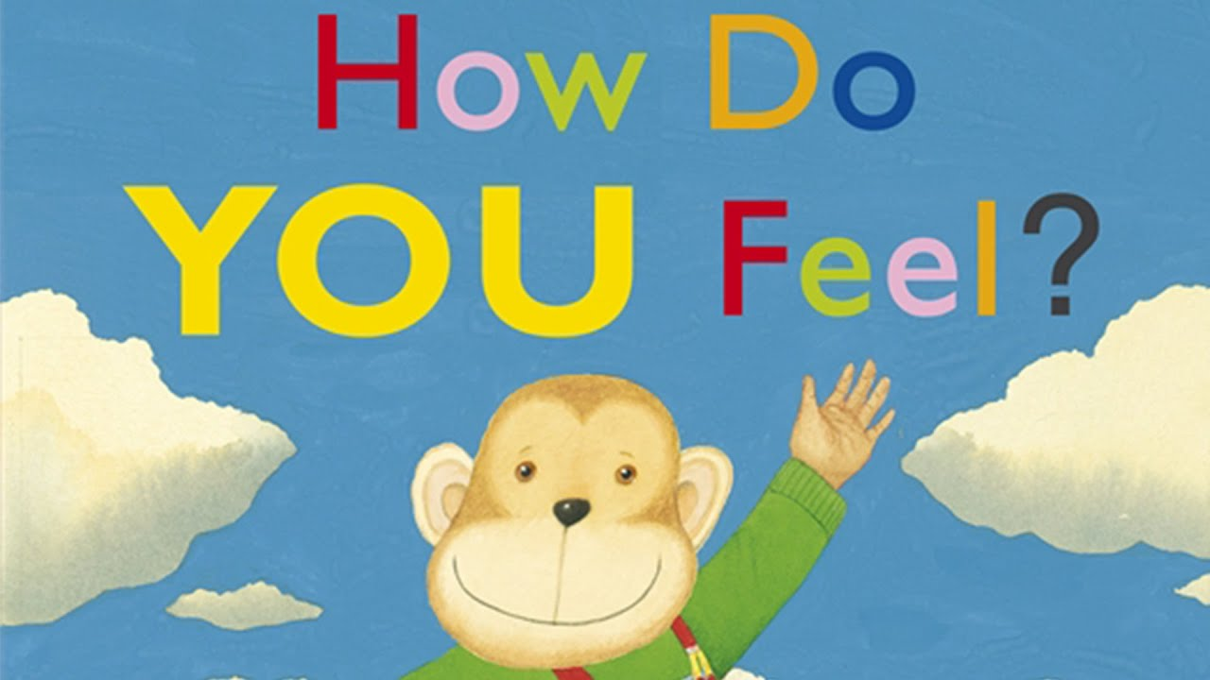

Slide 2
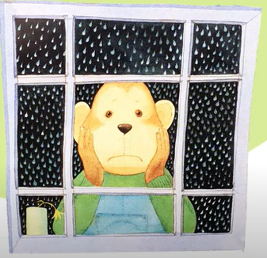
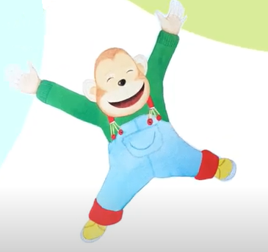
Can you identify these emotions?
HAPPY
SAD

Slide 3
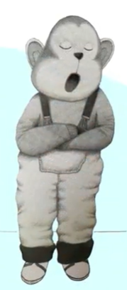
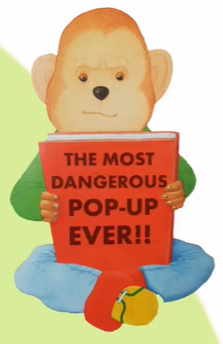
CURIOUS
BORED

Slide 4
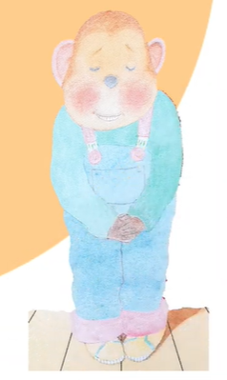
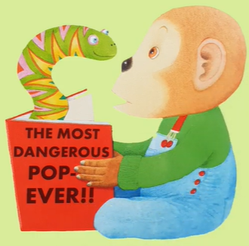
SURPRISED
SHY

Slide 5
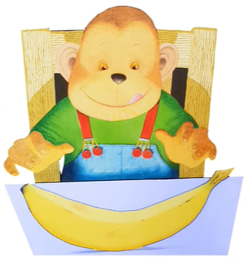
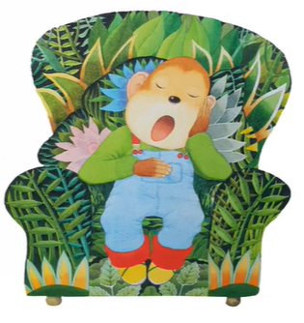
HUNGRY
SLEEPY

Slide 6
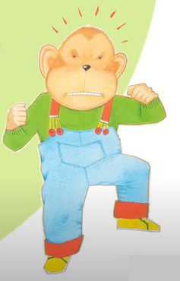
ANGRY

Slide 7
Short story: How do you feel? by Anthony Browne
Youtube link:
https://www.youtube.com/watch?v=MqrqxufmF1Q

