Slide 1
Clase de la semana del 07 al 11 de septiembre
No hay que hacer nada con este PPT porque se explicará en la clase.
Hay actividades de tarea en que van adjuntas en un documento word en material académico

Slide 2
English Class
Second grade 2020

Slide 4
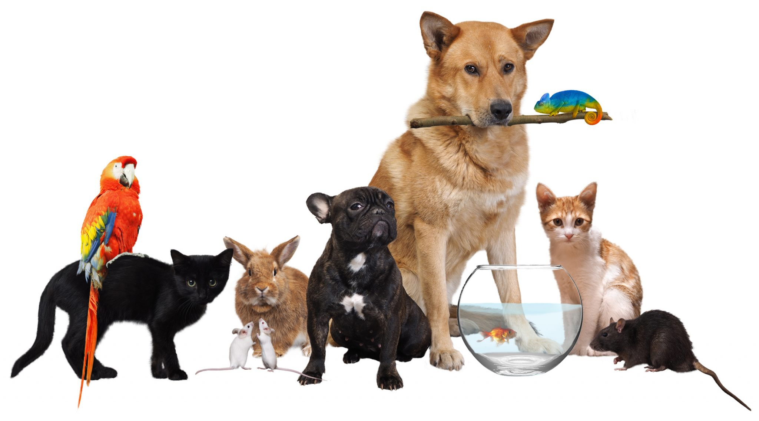
OBJECTIVE: Identify animals to talk about them.
Notes:
Let´s talk about animals

Slide 5
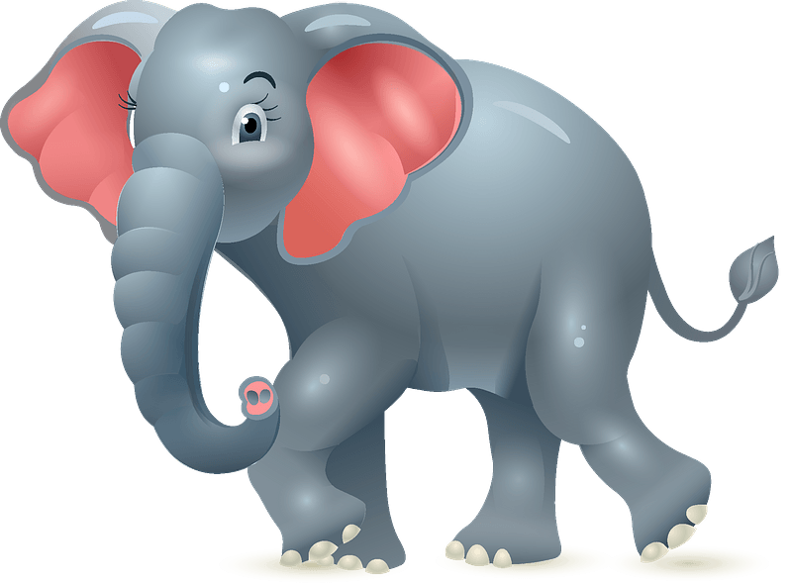
ANIMAL
CLASSIFICATION
PETS
WILD ANIMALS
Notes:
What is the difference between pets and wild animal?
Can you have an elephant as a pet? Why?

Slide 6
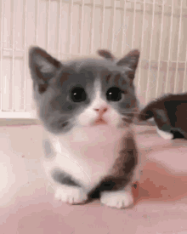
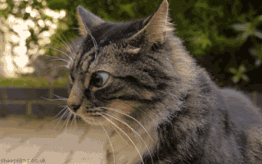
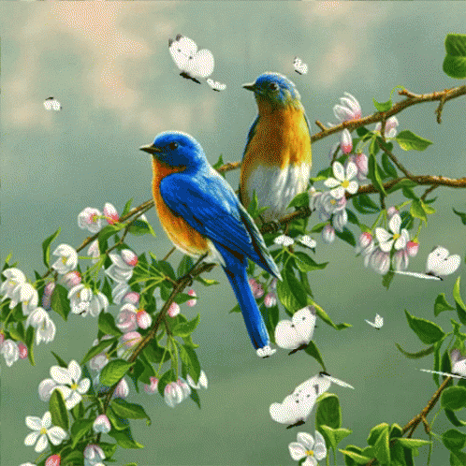
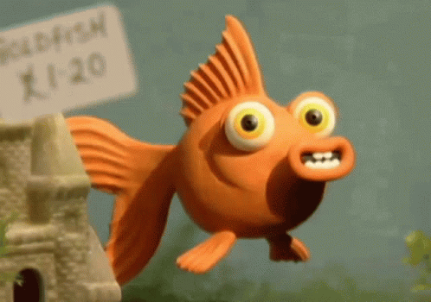
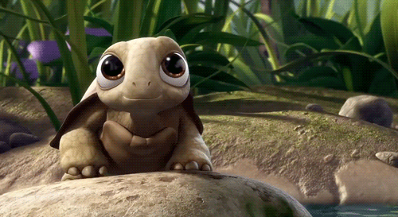
Vocabulary: PETS
puppy
dog
kitten
cat
birds
fish
rabbit
turtle

Slide 7
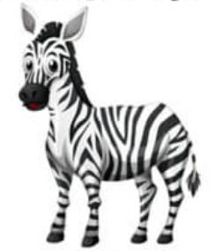
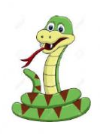
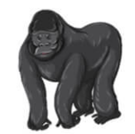
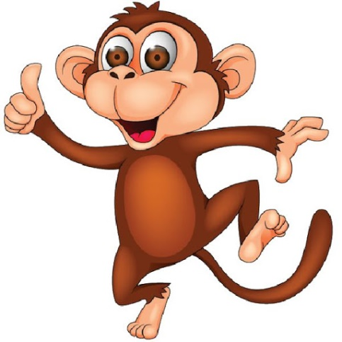
Vocabulary: WILD ANIMALS
zebra
snake
tiger
elephant
gorilla
monkey
dolphin
whale

Slide 8
Listen and guess the animal’s sounds

Slide 9
Look and guess the animal’s shadow

Slide 10
EXTRA
Do you have pets?
What pet do you have?

Slide 12
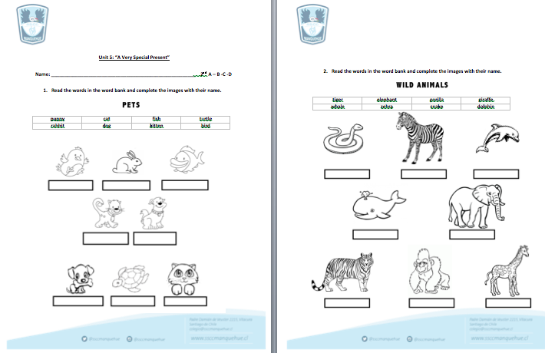
Complete the worksheets with the different PETS and WILD ANIMALS you have learnt.

Slide 13
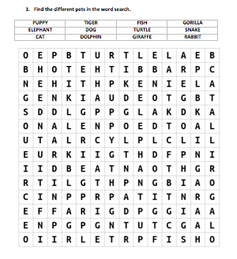
WORD SEARCH

