Slide 1
Clase de la semana del 1 de junio al 5 de junio
No hay que hacer nada con este PPT porque se explicará en la clase.
En esa clase se usará el libro para completar unas actividades.
Si no tienes el libro, las paginas a usar van adjuntas en un documento word en material academico

Slide 2
Class 1
May 25th , 2020

Slide 3
INSTRUCCIONES
1. SILENCIAR EL MICRONO AL ENTRAR A LA CLASE.
2. SI EL INTERNET FALLA SE RECOMIENDA APAGAR LA CAMARA.
3. USAR EL CHAT PARA PREGUNTAR O LEVANTAR LA MANO.
4. PARA PARTICIPAR PRENDER EL MICROFONO (solo si el profesor/a se lo indica).
5. TENER EL LIBRO A MANO Y EL CUADERNO.
6. SER RESPETUOSO Y UTIIZAR UN LENGUAJE APROPIADO.

Slide 4
Dear all, here you have the objectives for today´s class
Identify want to, to answer personal information

Slide 5
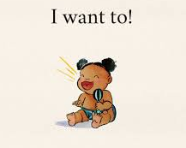
Want to

Slide 6
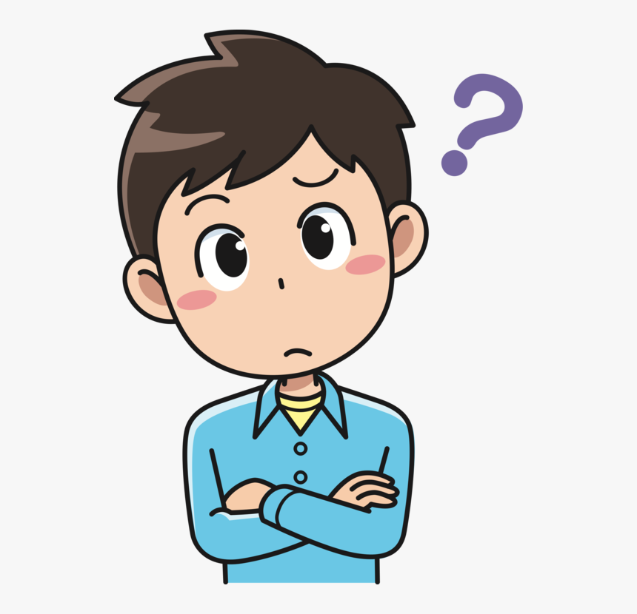
How do we use want to?
I – YOU – WE - THEY
I want to
You want to
We want to
They want to
Example: I want to draw
you want to play the guitar
HE – SHE – IT
He wants to
She wants to
It wants to
Example: He wants to eat spaghetti She wants to listen to music

Slide 7
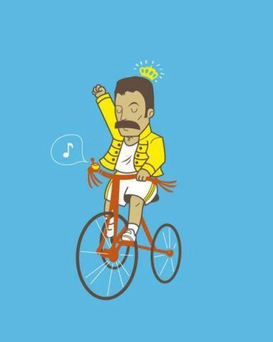
What do you want to do?

Slide 8
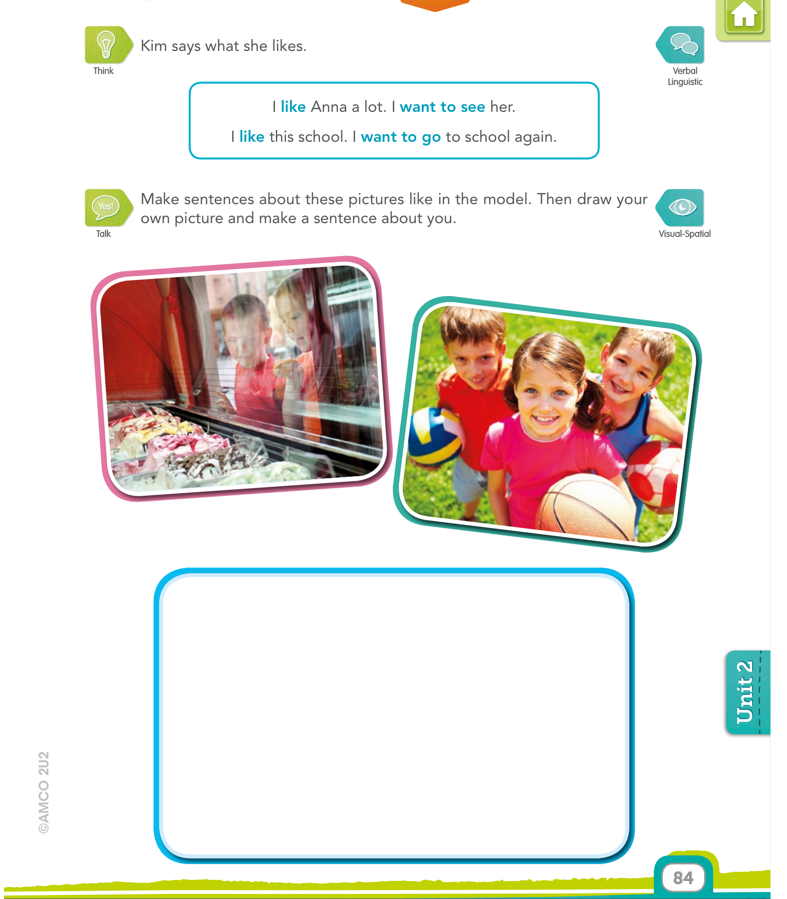
The children want to eat ice cream
2. The children like to practice different sports

Slide 9
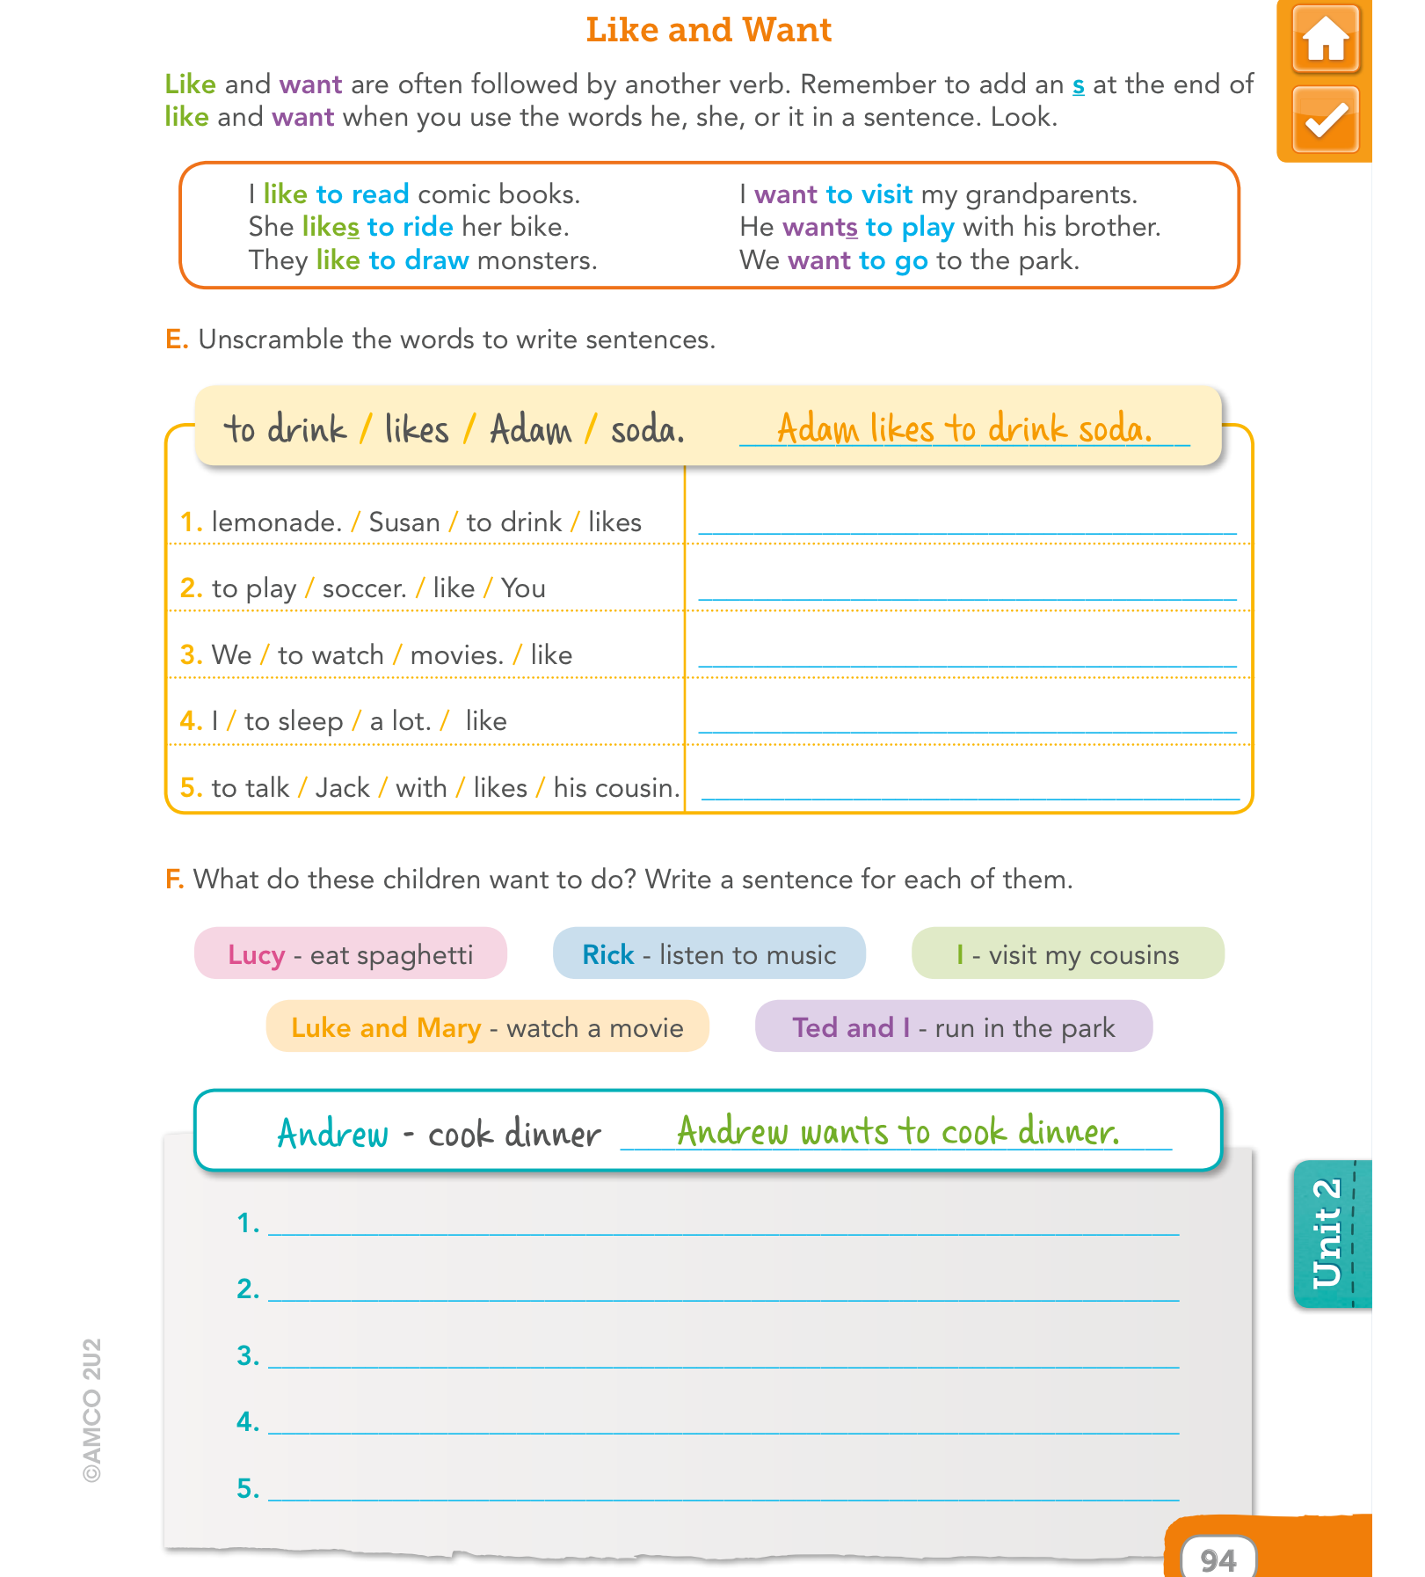
4
1
3
2
Susan likes to drink lemonade
You like to play soccer
We like to watch movies
I like to sleep a lot
Jack likes to talk with his cousin
Lucy wants to eat spaghetti
I want to visit my cousins
Rick wants to listen to music
Luke and Mary want to watch a movie
Ted and I want to run in the park

