Slide 1


Class 4
May 8th , 2020

Slide 2

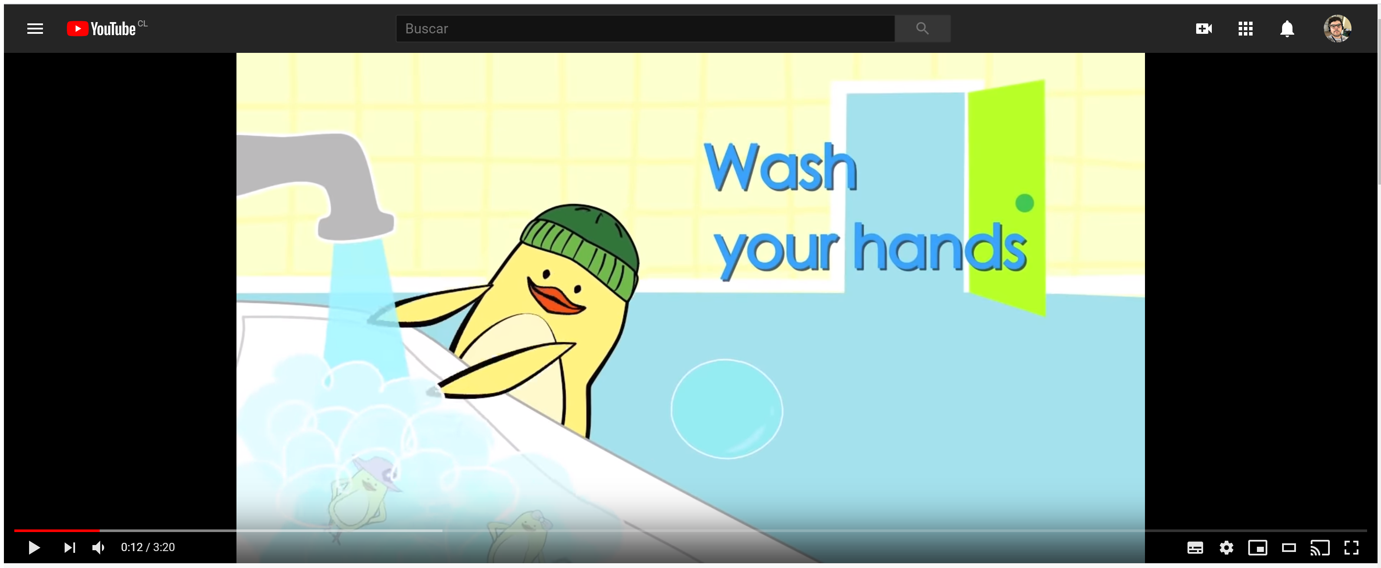

https://www.youtube.com/watch?v=dDHJW4r3elE

Slide 3
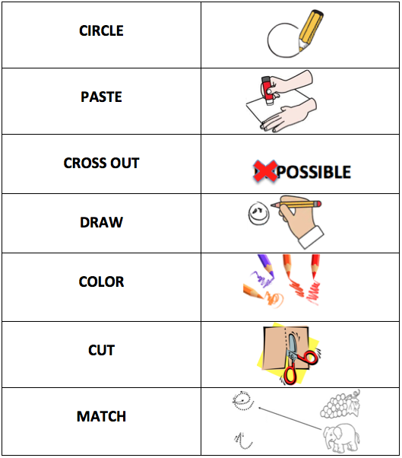

Cuaro te texto

Slide 4
Dear all, here you have the objective for the first part of the class
Main objective:
Identify school things to name them in a conversation

Slide 5


Slide 6

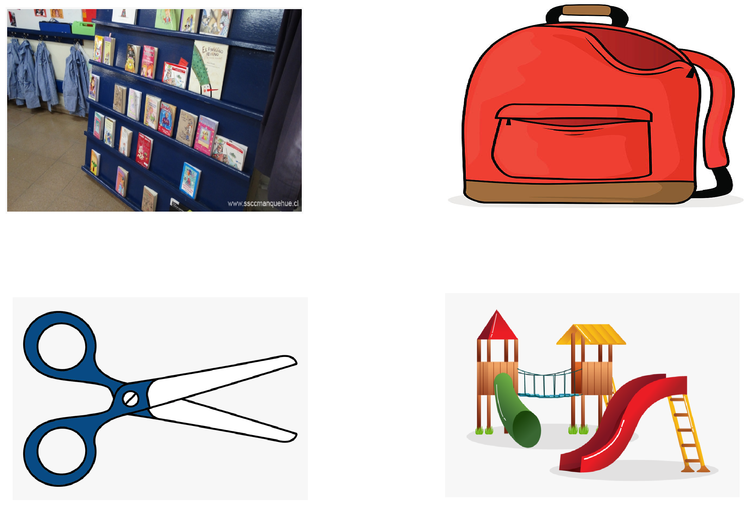
School things
Bookcase
Backpack
Scissors
Playground

Slide 7
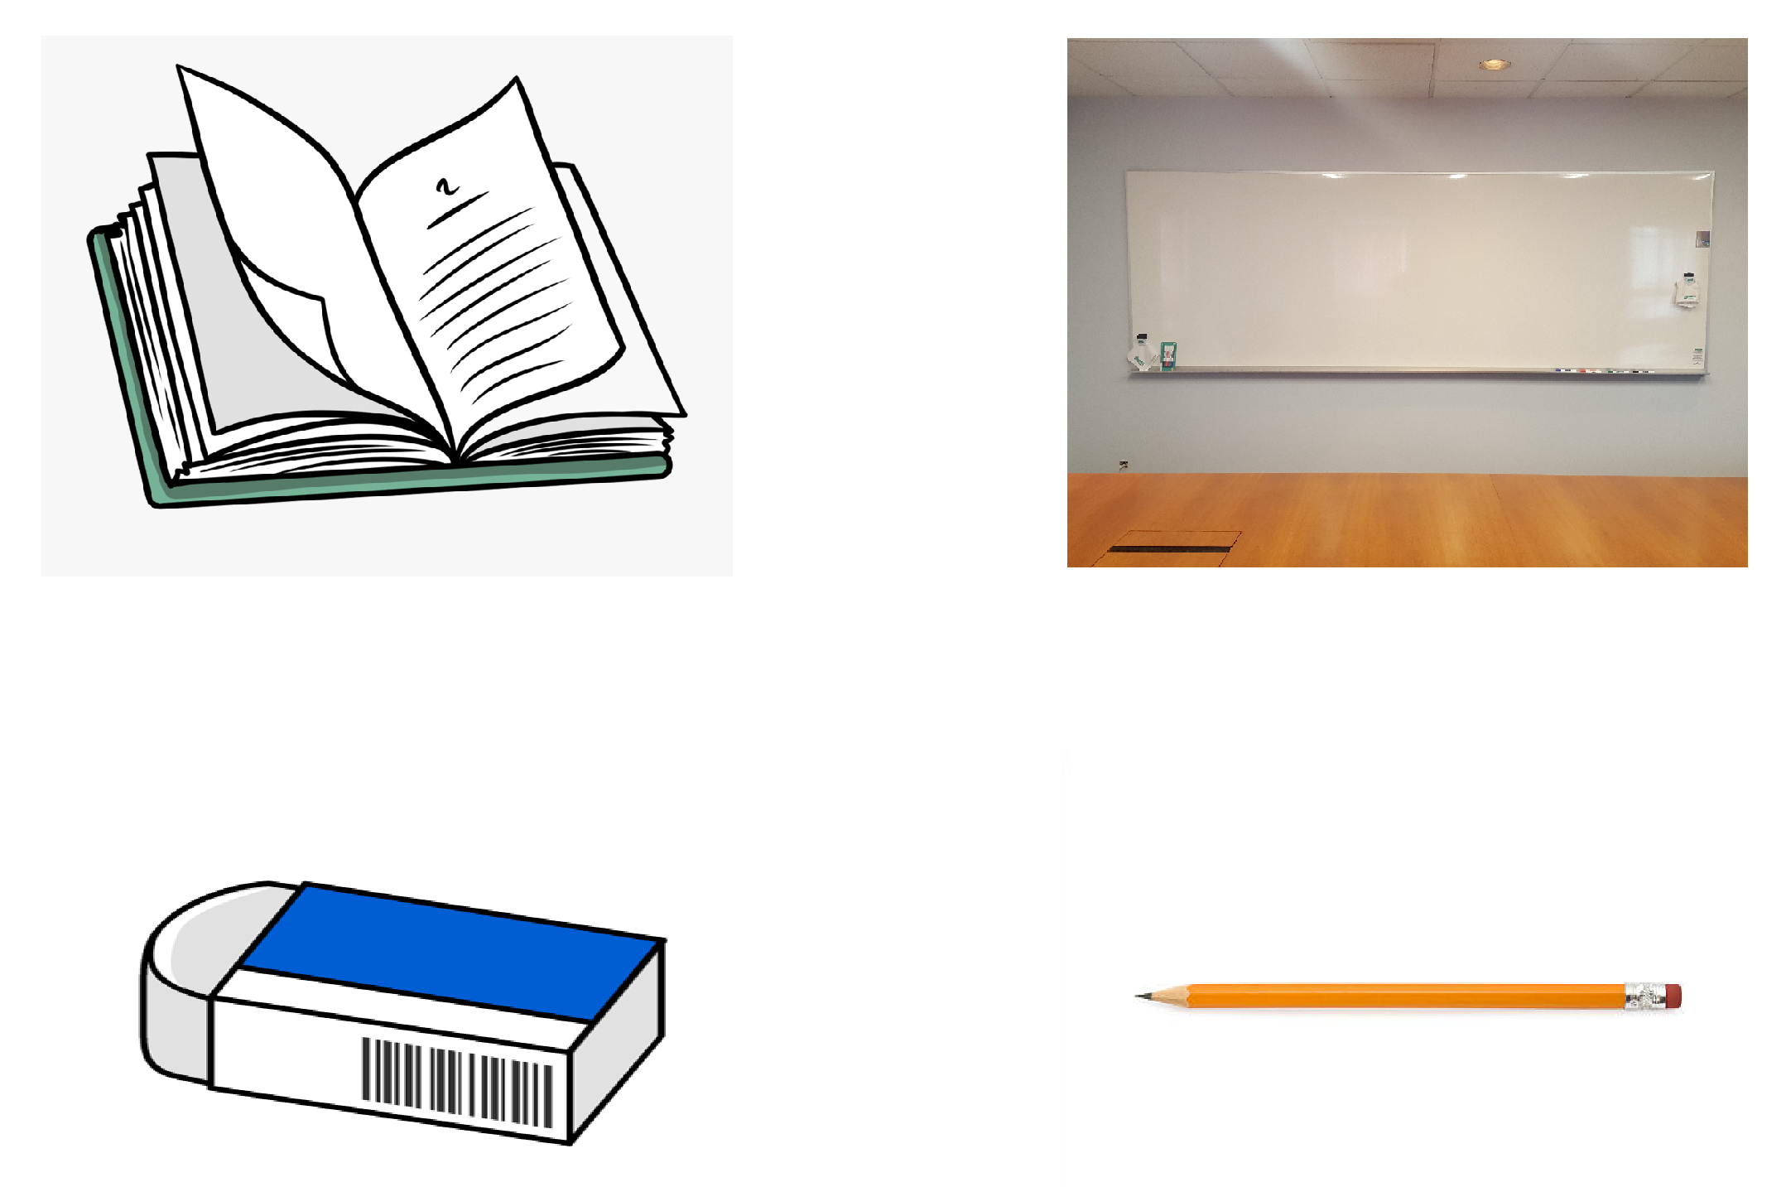
School things
Book
Whiteboard
Eraser
Pencil

Slide 8
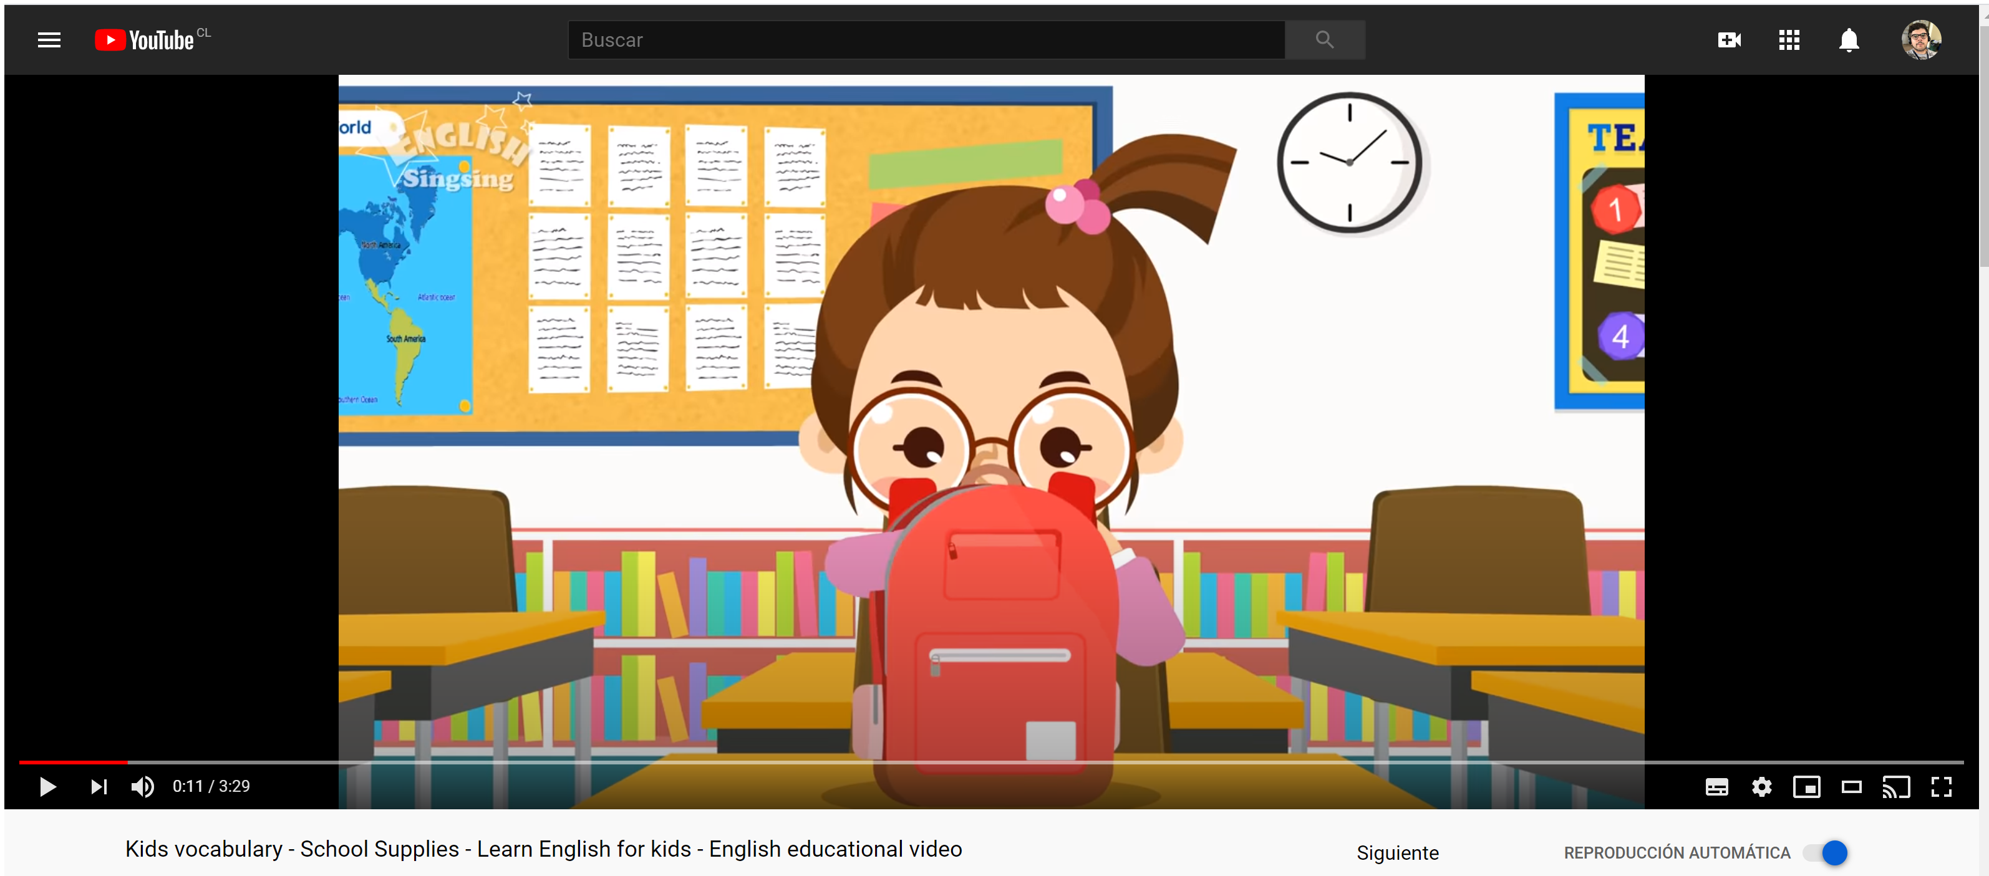
https://www.youtube.com/watch?v=AS5nhKzaOqo

Slide 9
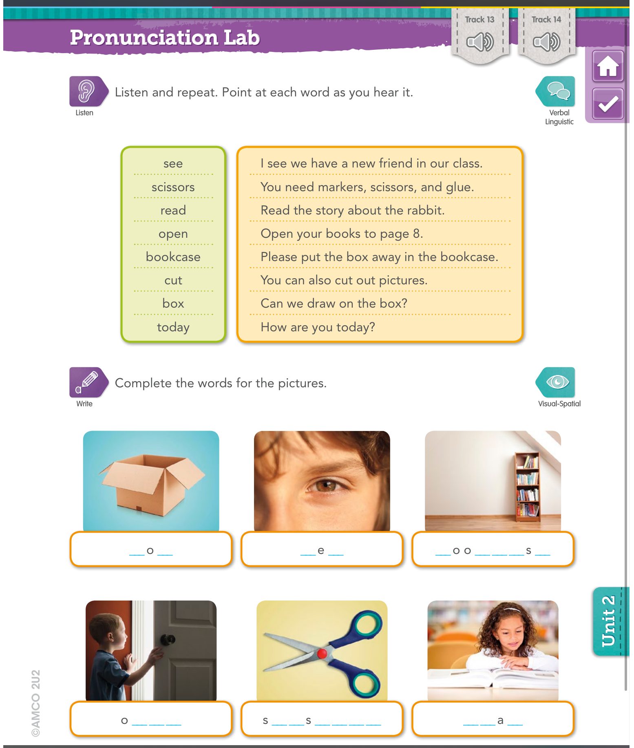

Slide 10
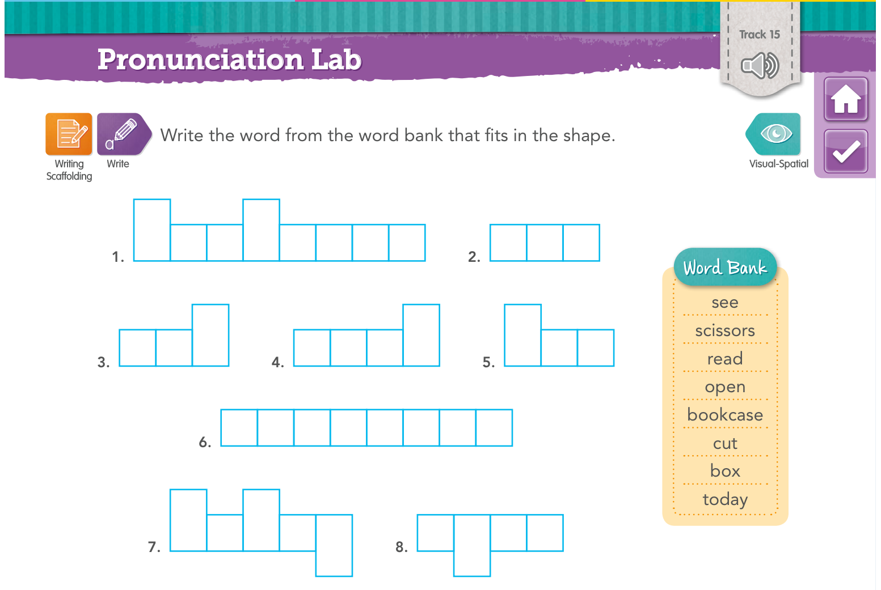

Slide 11
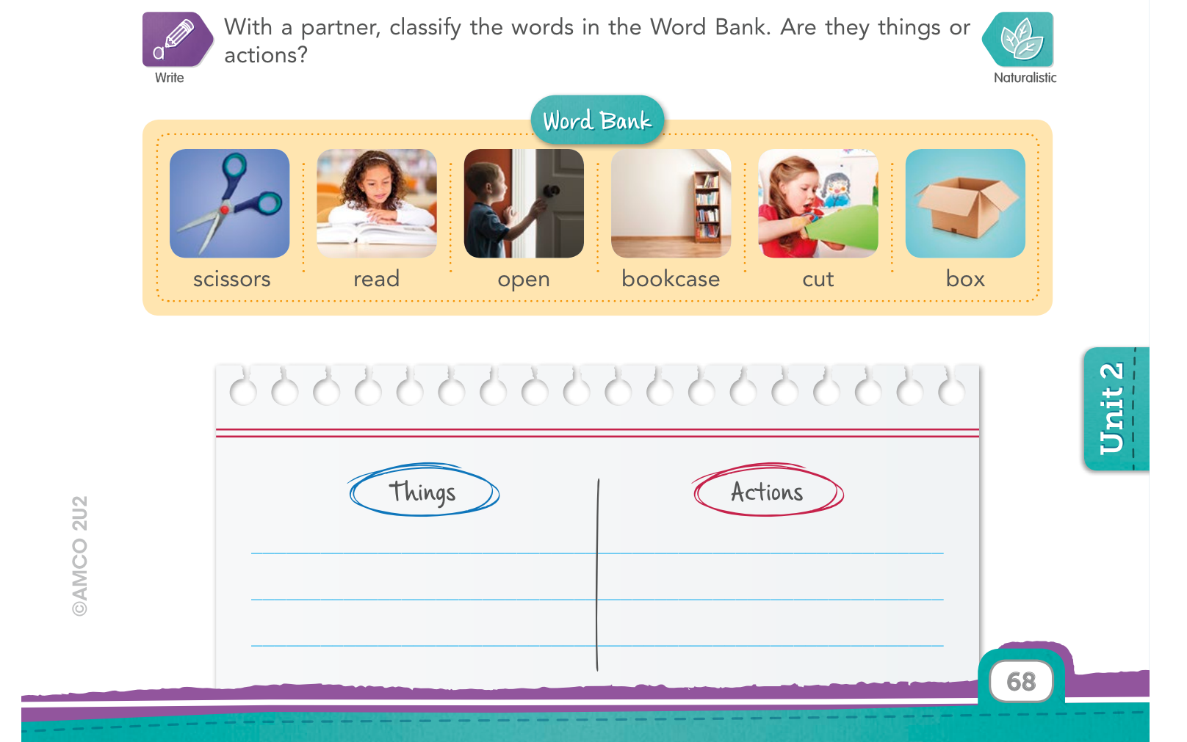

Slide 12

Part 2

Slide 13
Dear all, here you have the objective for the second part of the class
Main objective:
Identify general and specific information from an oral text to show listening comprehension

Slide 14
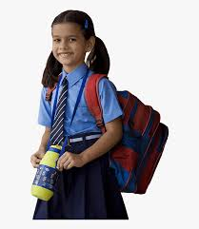
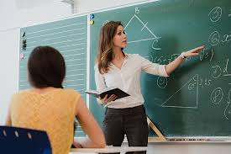

We are going to listen to a conversation
→ But first, look at the pictures and let’s make some predictions about the conversation

Slide 15
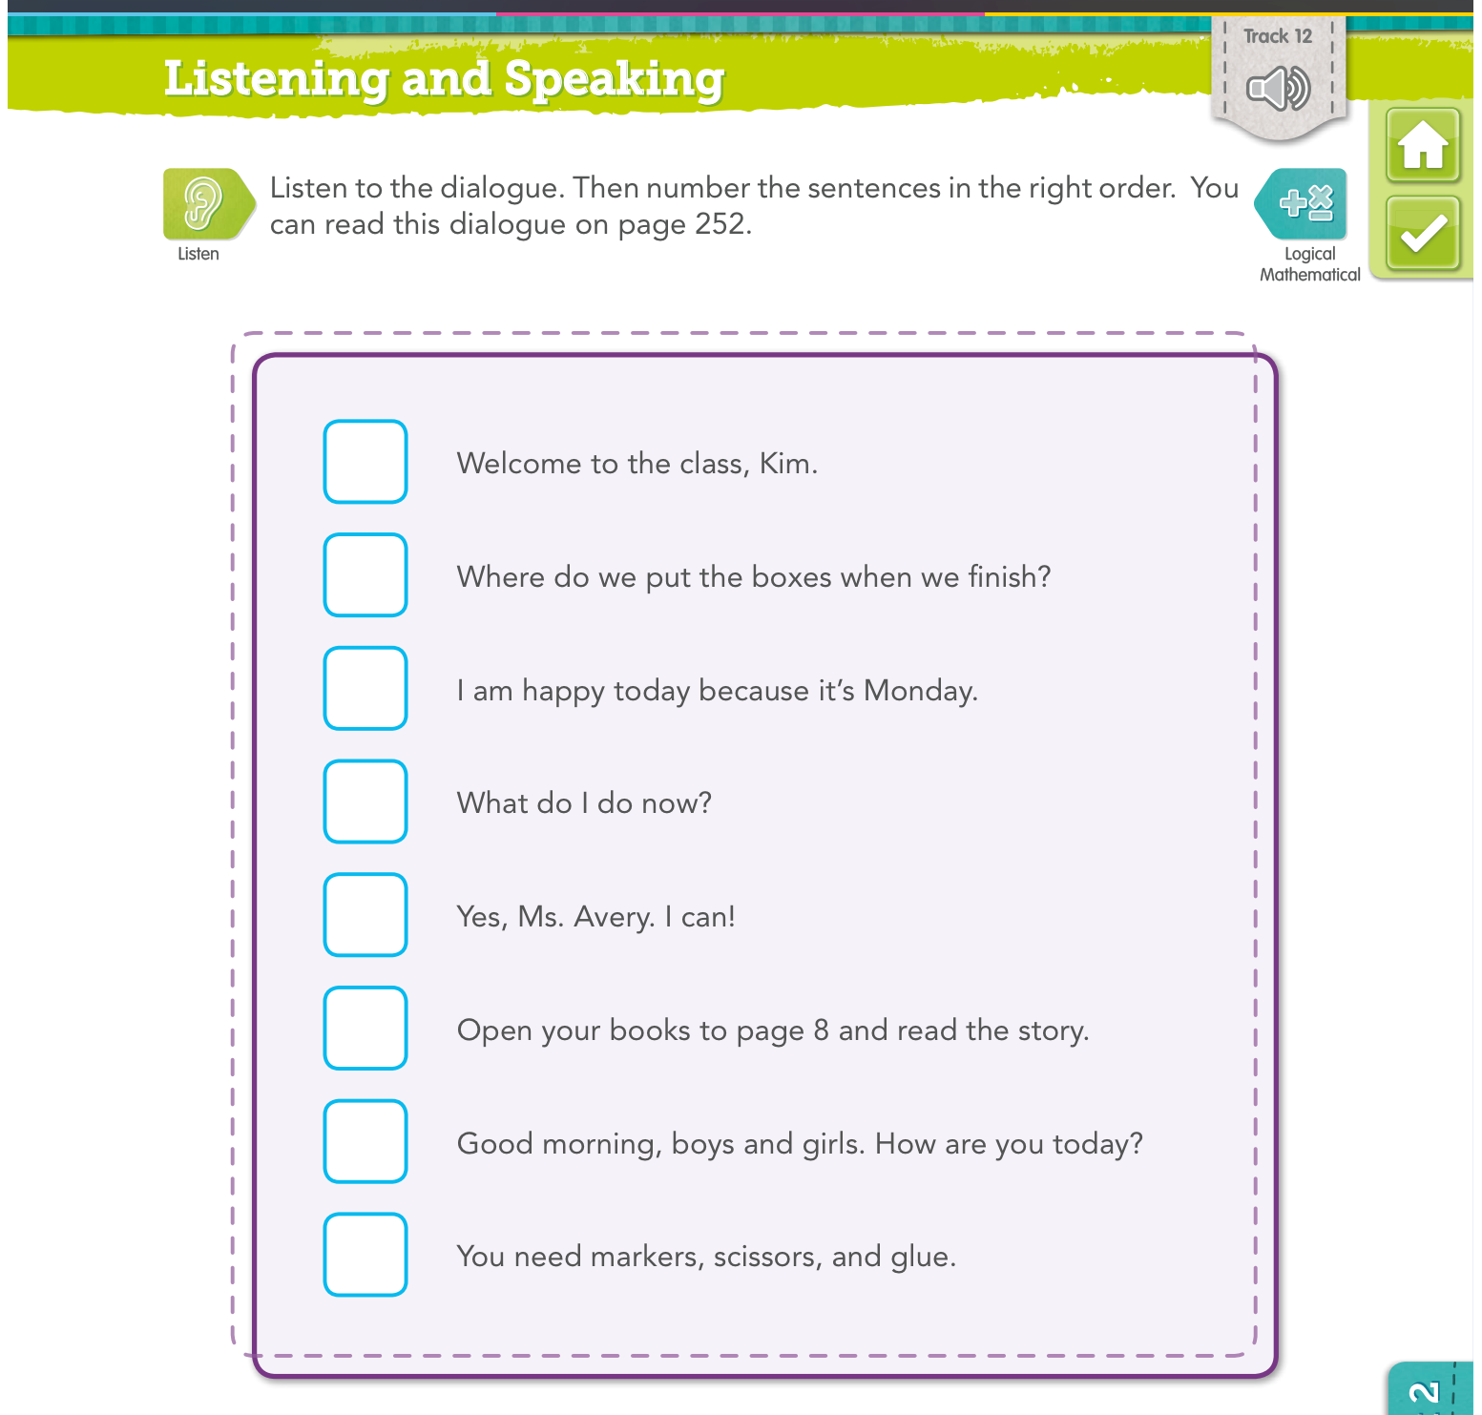

Slide 16
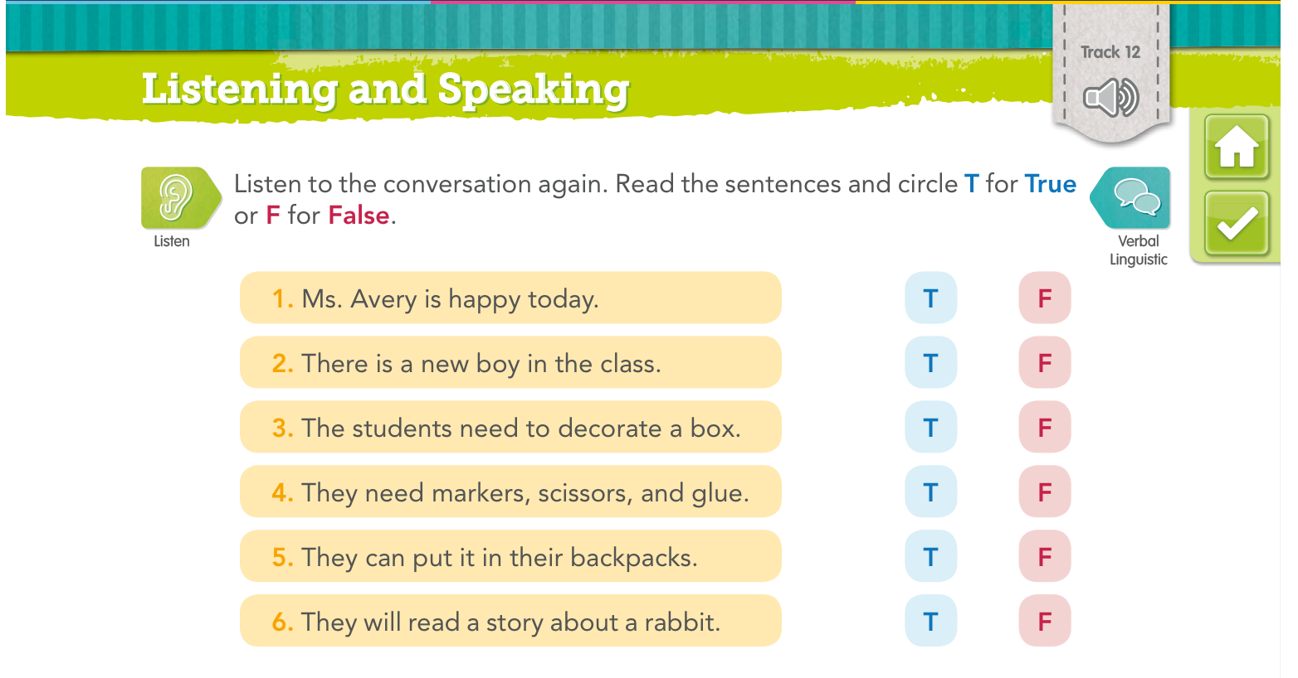

Slide 17


