Slide 1
Clase de la semana del 25 de mayo al 29 de mayo 2020
Este PPT ya se explicó en la clase que tuvimos
Este PPT no tiene guías de trabajos ni paginas del libro para completar
Esta semana no se envió tarea

Slide 2


Class 1
May 25 - 29 , 2020

Slide 3

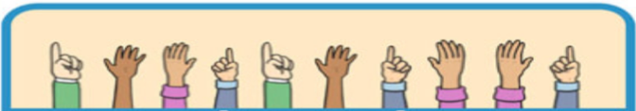




INSTRUCCIONES
1. SILENCIAR EL MICRONO AL ENTRAR A LA CLASE.
2. SI EL INTERNET FALLA SE RECOMIENDA APAGAR LA CAMARA.
3. USAR EL CHAT PARA PREGUNTAR O LEVANTAR LA MANO.
4. PARA PARTICIPAR PRENDER EL MICROFONO (solo si el profesor/a se lo indica).
5. TENER EL LIBRO A MANO Y EL CUADERNO.
6. SER RESPETUOSO Y UTIIZAR UN LENGUAJE APROPIADO.

Slide 4


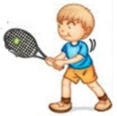
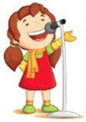


OBJECTIVES
Identify school things to name them.
Identify use of like to

Slide 5

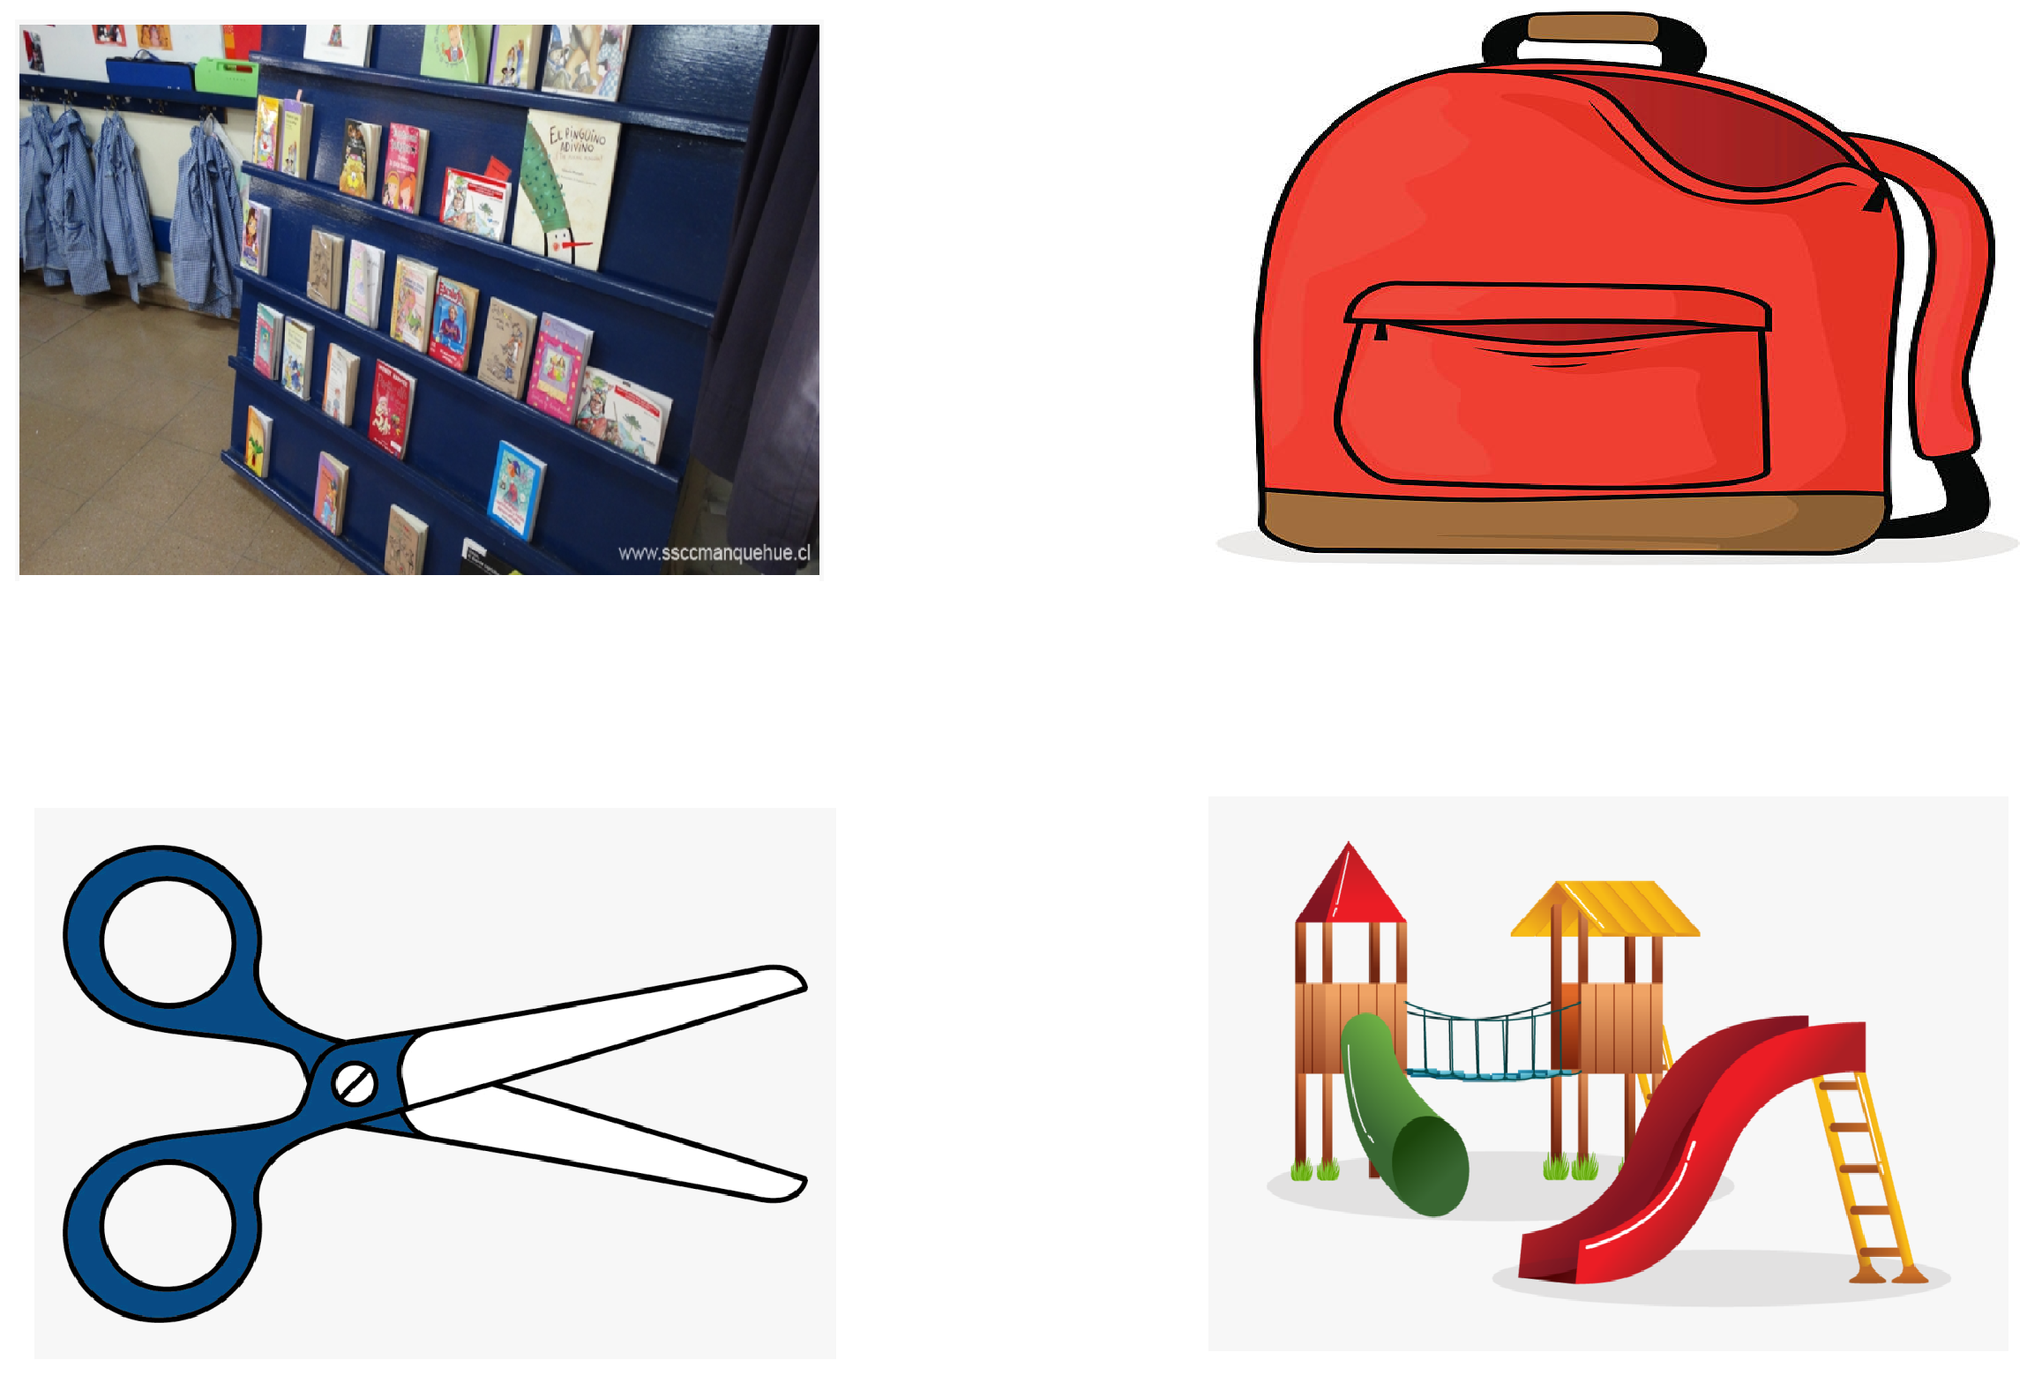
School things
Bookcase
Backpack
Scissors
Playground

Slide 6
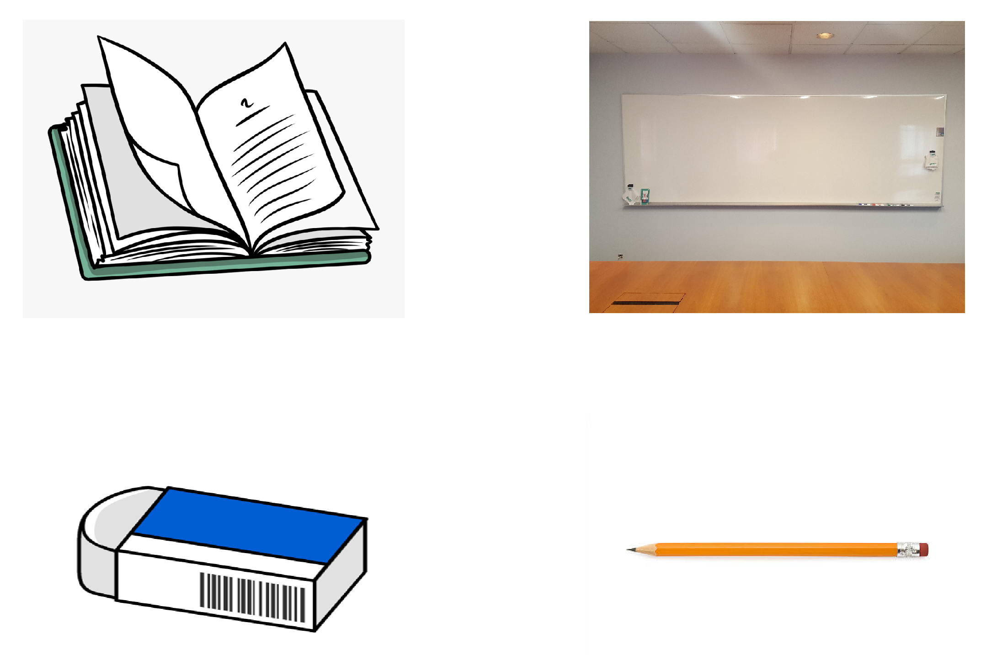
School things
Book
Whiteboard
Eraser
Pencil

Slide 7
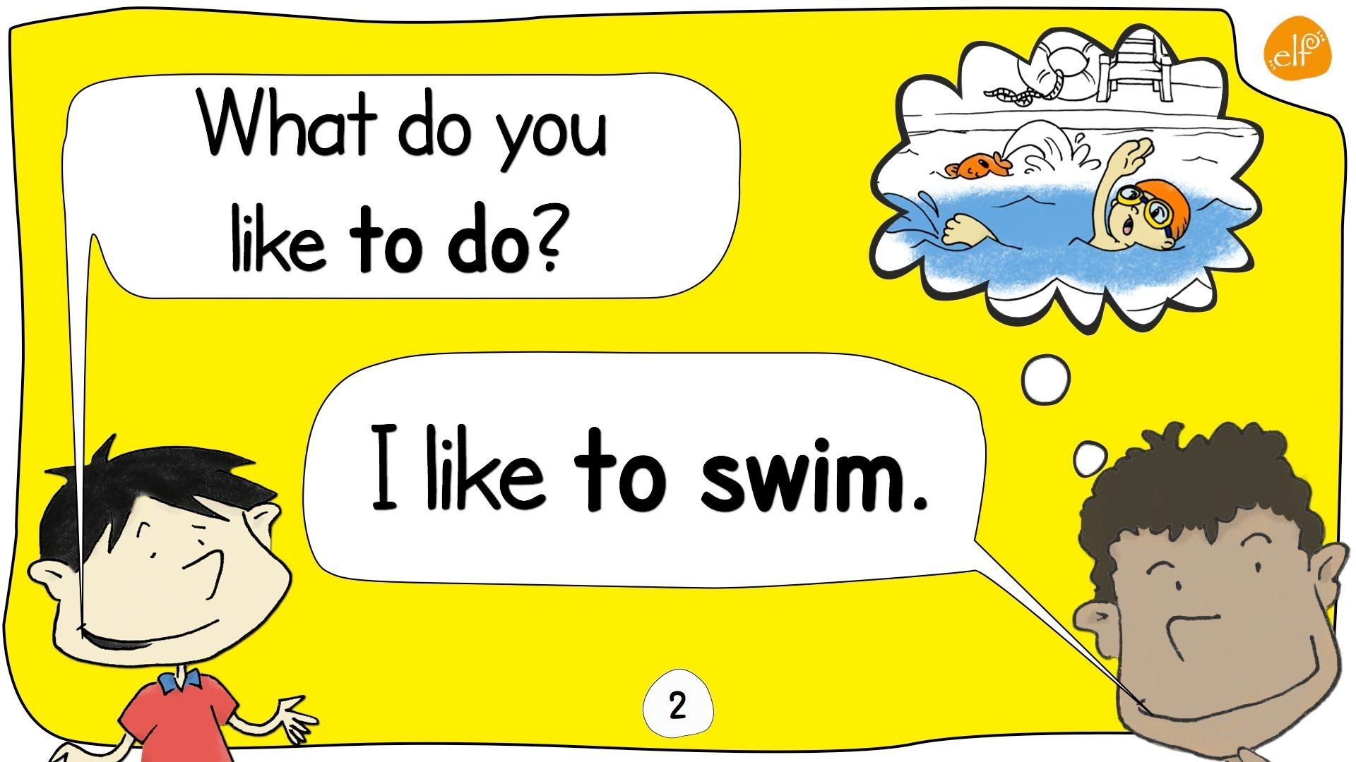

Like to

Slide 8
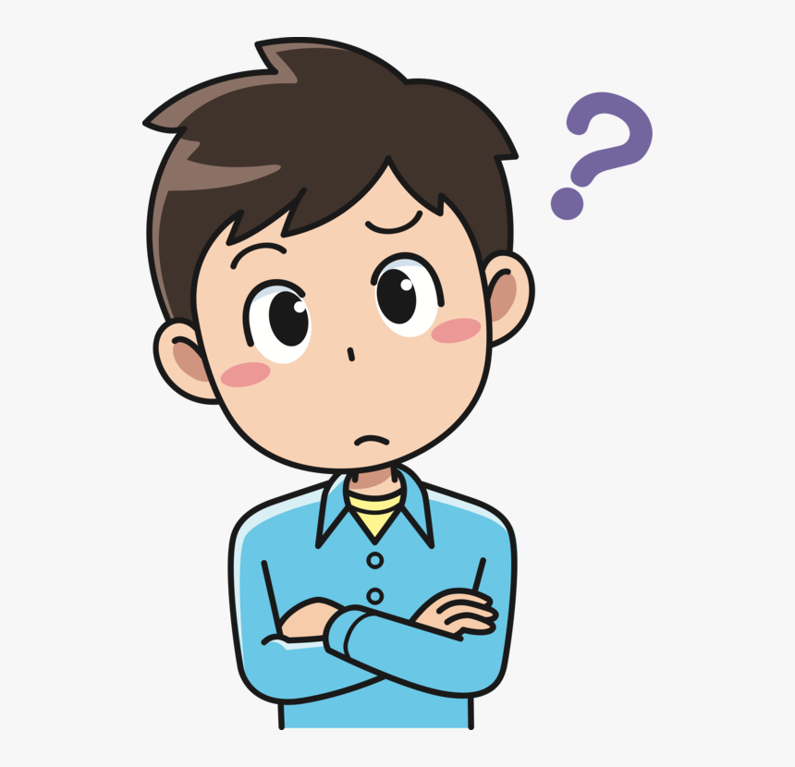
How do we use like to?
I – YOU – WE - THEY
I like to
You like to
We like to
They like
Example: I like to play soccer
you like to sing songs
HE – SHE – IT
He likes to
She likes to
It likes to
Example: My sister likes to draw and color
My dad likes to study English

Slide 9
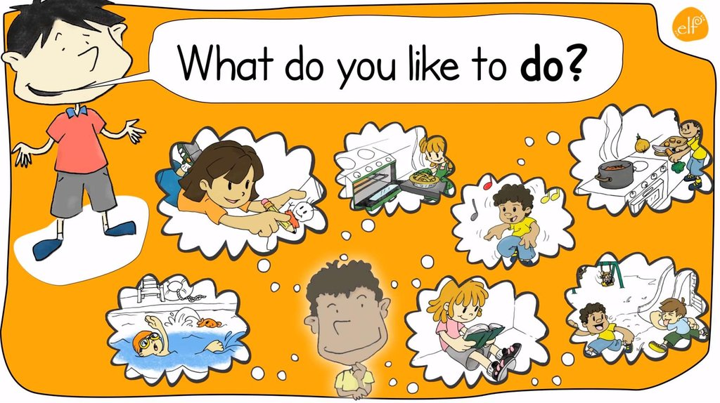

Slide 10


Slide 11
https://www.youtube.com/watch?v=41cJ0mqWses
SCHOOL SUPPLIES
LIKE TO – LIKES TO
https://www.youtube.com/watch?v=am3lvL6GGpk

