Slide 1
Class 5
May 15th , 2020

Slide 2
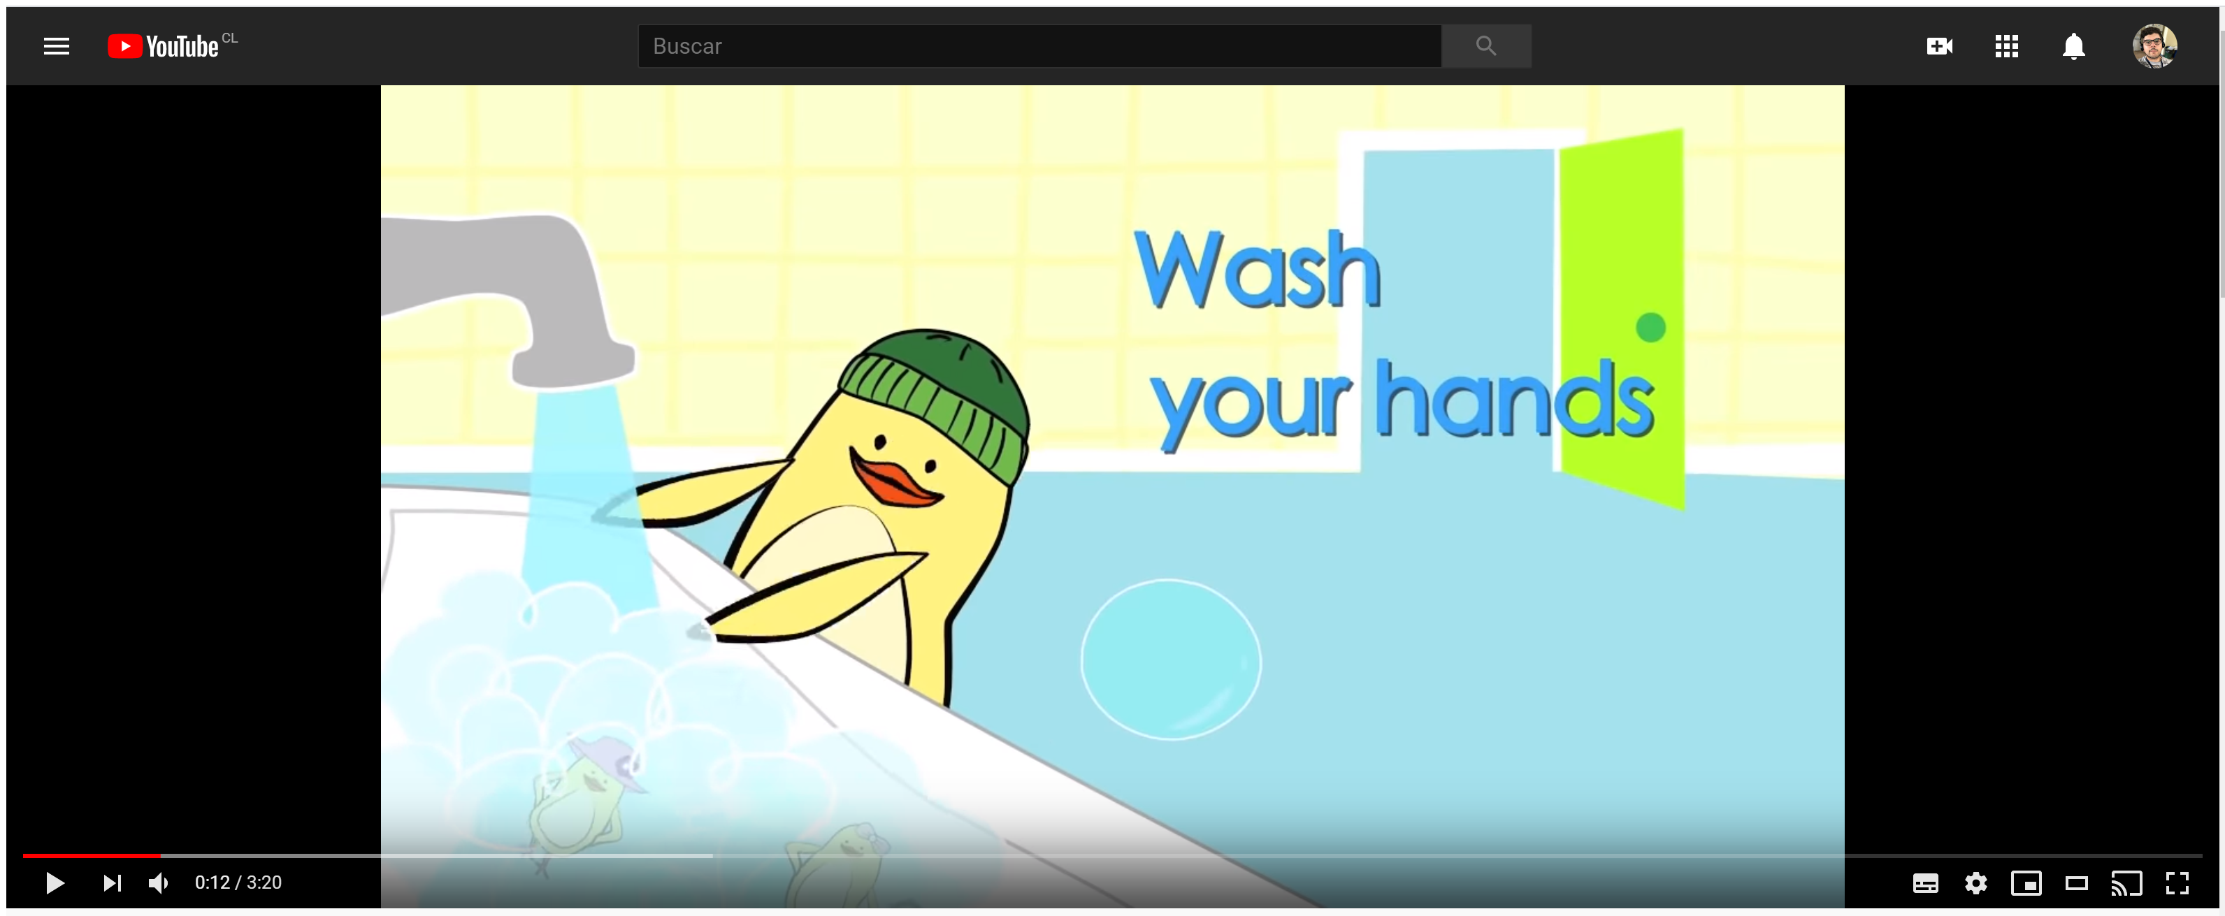
https://www.youtube.com/watch?v=dDHJW4r3elE

Slide 3
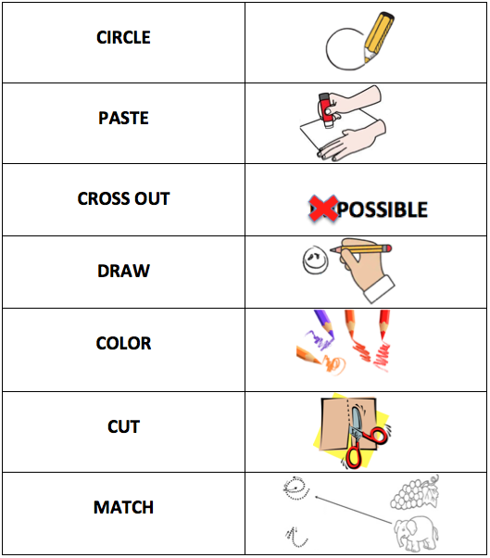
Cuaro te texto

Slide 4
Dear all, here you have the objectives for today´s class
Identify general and specific information to sequence events
Identify specific information to show reading comprehension

Slide 5
Pre-reading
Before reading a story, we do pre-reading activities to be more prepared for what we are going to read

Slide 6
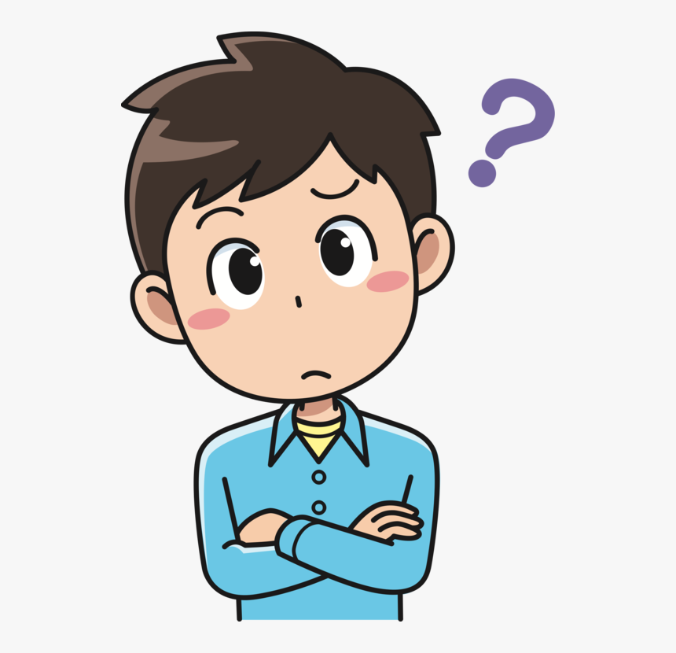
Pre-reading activities
Title
For this activity, I will show you the tittle of the story and you will guess what is the story about
What do you think is the story about?

Slide 7
The story is about the first day at school of a girl
The story is about Kim going to the park
The story is about 2 friends on vacations

Slide 8
Page 70

Slide 9
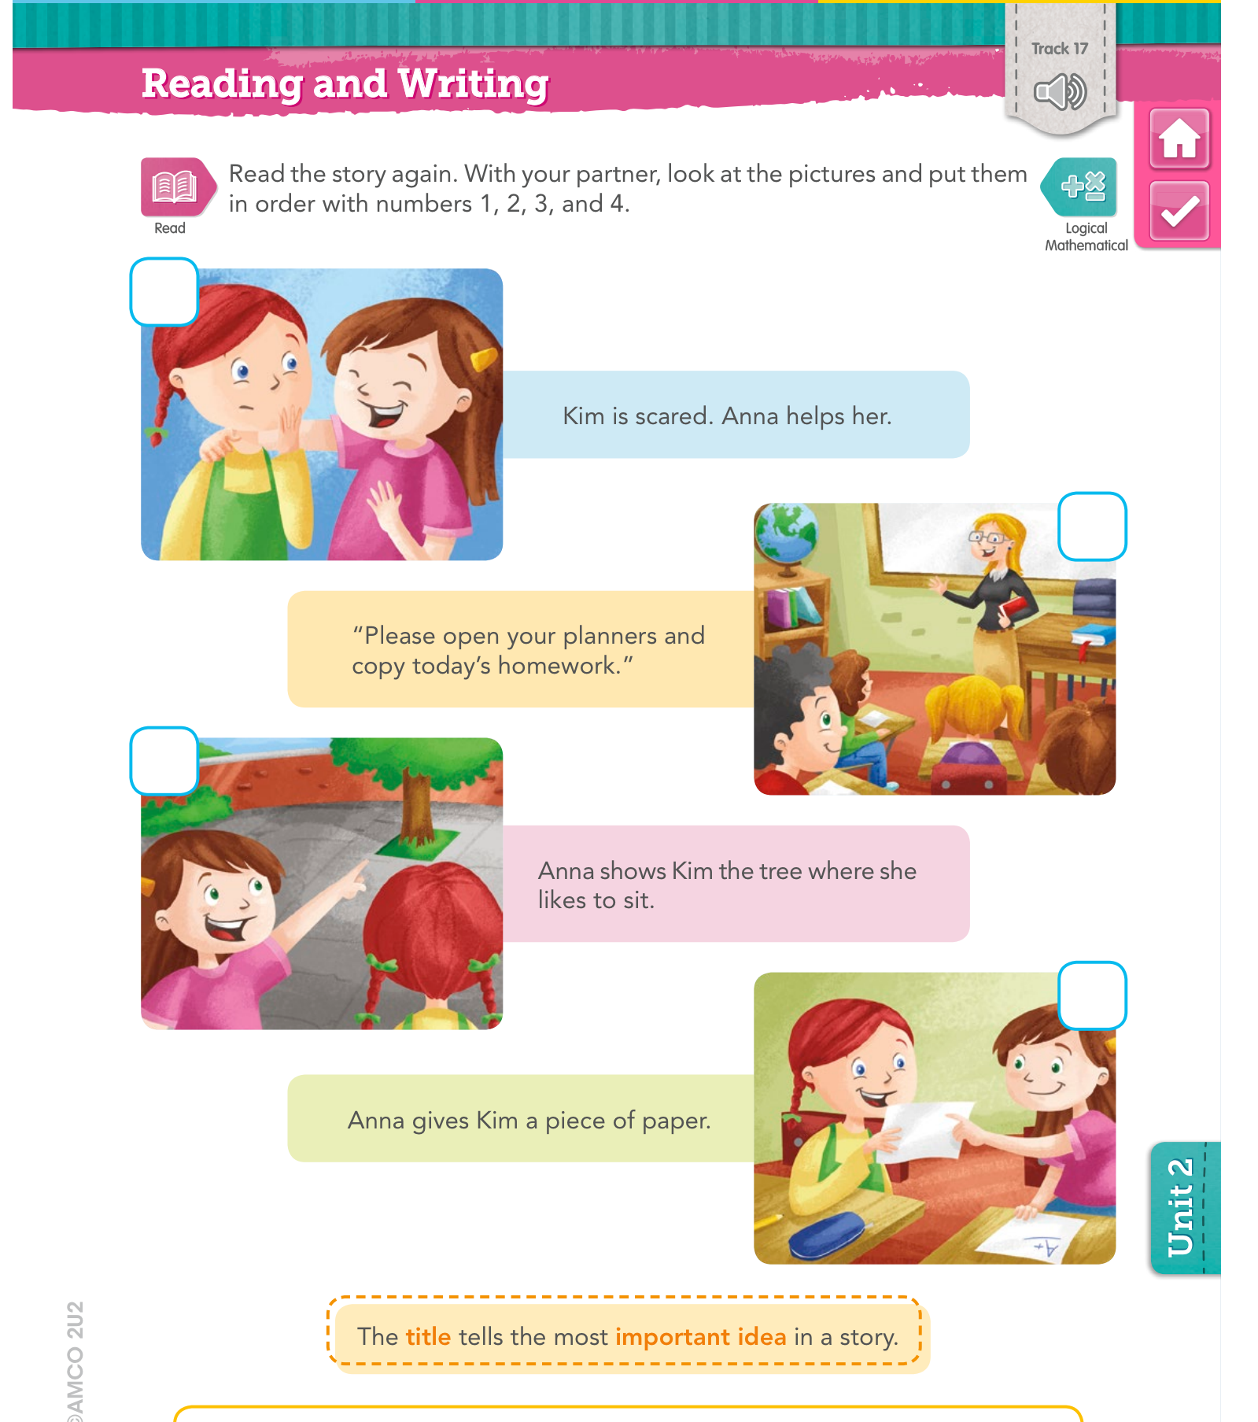

Slide 10
